Slide 1
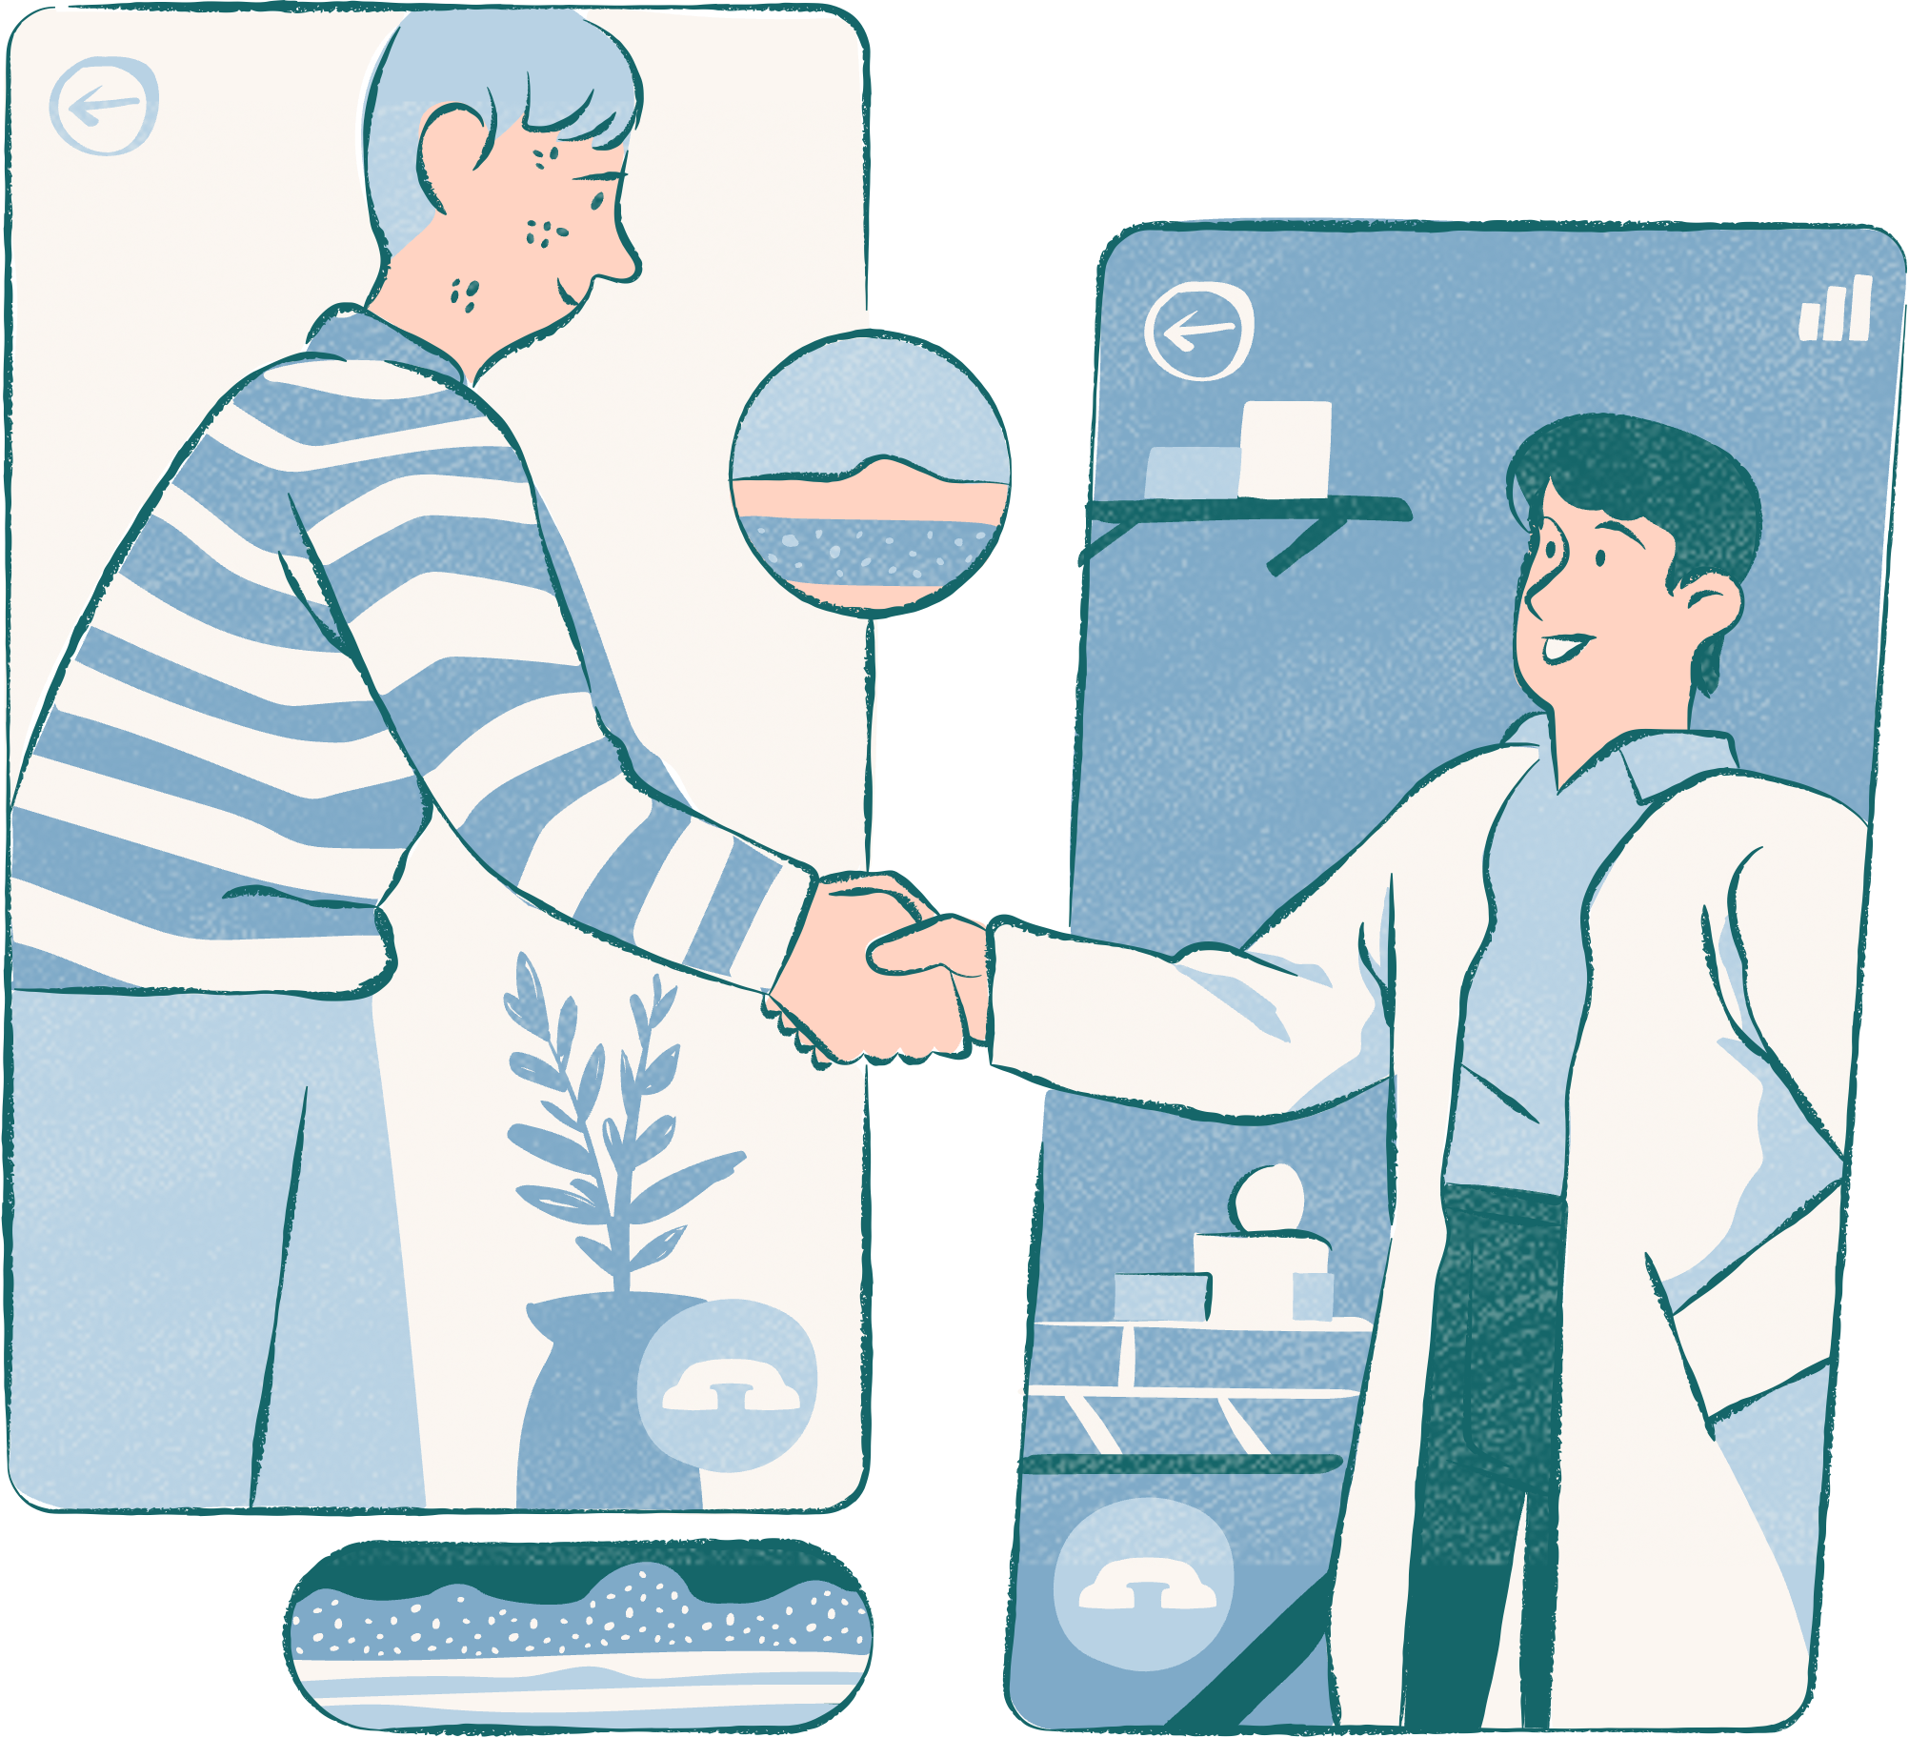
BayMax
Your healthcare companion !
Independent Study Project By: Manasvini Nittala
NET ID : mn777
mn777@rutgers.edu

Slide 2
TABLE OF CONTENTS
Introduction | Outputs
Motivation | Future Work
Outline | Conclusion
Model | References

Slide 3

INTRODUCTION
In the BayMax Django web application, two pivotal models, the Disease Prediction Model, and the Drug Name Recommendation Model, seamlessly integrate to enhance healthcare interactions.
The Patient Dashboard employs the Disease Prediction Model, offering users proactive health insights for anticipating potential ailments.
Simultaneously, the Doctor Dashboard utilizes the Drug Name Recommendation Model, employing machine learning to suggest optimal drug names for personalized treatment plans.
To address misunderstandings, patients can effortlessly request appointments with healthcare providers, ensuring a human touch in the era of AI-driven healthcare solutions.

Slide 4

MOTIVATION
Facilitates Easy Home Diagnoses: BayMax empowers individuals to conduct preliminary health assessments from the comfort of their homes, streamlining the diagnostic process and reducing the need for hospital visits.
Optimizes Drug Prescriptions: Through advanced machine learning, BayMax's Drug Name Recommendation Model ensures personalized and optimized drug prescriptions, enhancing the efficacy of treatment plans.
Seamless Communication Channels: BayMax establishes direct communication channels between patients and healthcare providers, fostering a bridge for clarifications and appointments and promoting a patient-centric approach to healthcare.

Slide 5
OUTLINE
User Registration and Authentication:
Patient and doctor registration with HTML forms
Django-based authentication for secure access
Profile creation for personalized user experiences
Appointment Handling:
Patient initiates an appointment request through the UI
Request details stored in MySQL database
Confirmation sent to the patient
01.
04.
Patient Dashboard:
User-friendly UI displaying relevant health information
MySQL integration for seamless data storage
Symptom input form for preliminary diagnosis
Doctor Dashboard:
Doctor authentication to access the dashboard
User-friendly UI for drug recommendation and appointment management
MySQL integration for data retrieval
02.
05.
Disease Prediction Model (ML Algorithms):
Logistic Regression, Naive Bayes, Random Forest, Decision Trees, MLP for disease prediction
Predicted results displayed on the patient dashboard
Drug Name Recommendation Model:
Naive Bayes and Random Forest used for drug prediction
Patient data retrieved for personalized drug recommendations
03.
06.

Slide 6
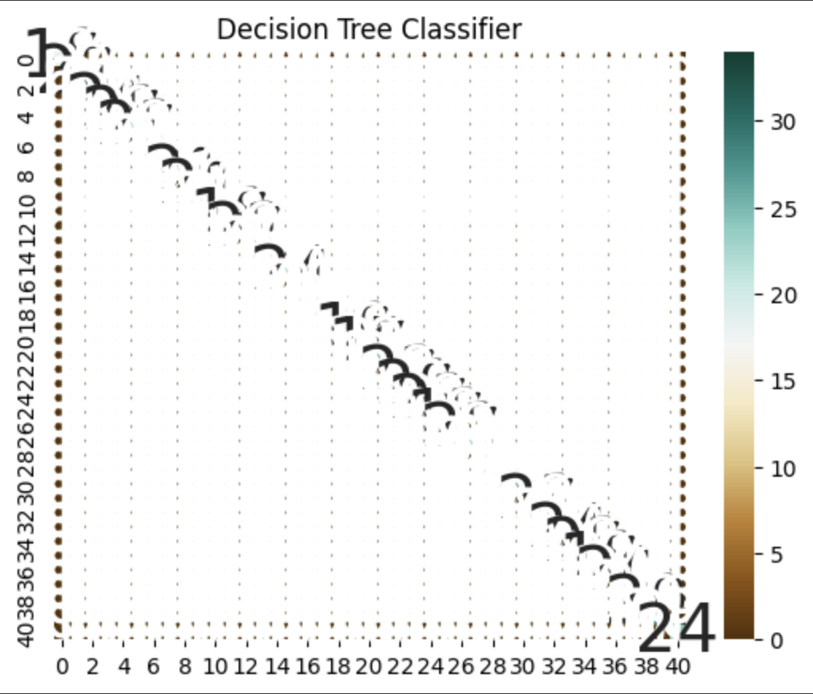
MODELS
Disease Prediction Model Selection:
Employing the Decision Tree model for disease prediction within BayMax, achieving a robust mean accuracy of 90%.
The serialized Decision Tree model is exported as a pickle file, enabling seamless integration and retrieval for real-time predictions.
Drug Recommendation Model Choice:
Opting for the Random Forest model for drug recommendation, showcasing a mean accuracy of 75%.
The Random Forest model is serialized into a pickle file, facilitating efficient usage and integration into the doctor dashboard for personalized drug recommendations.

Slide 7
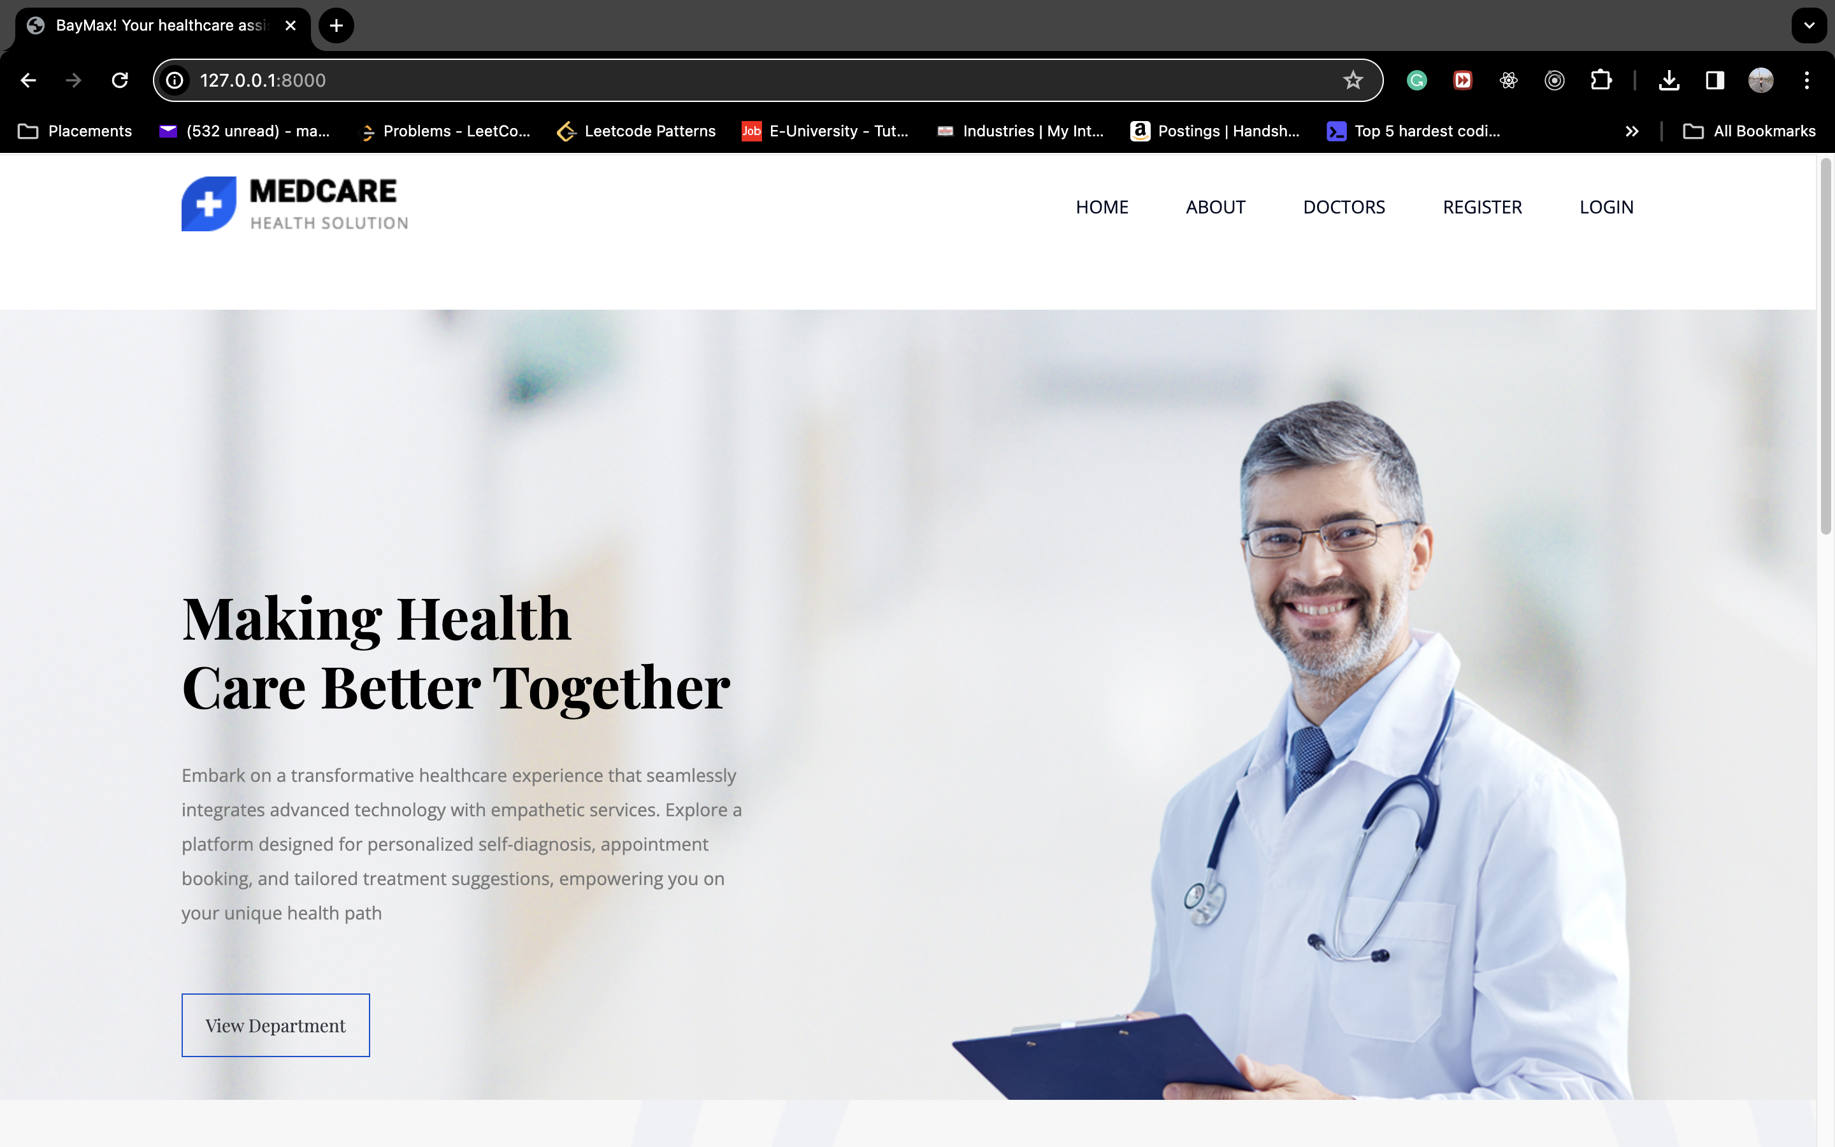
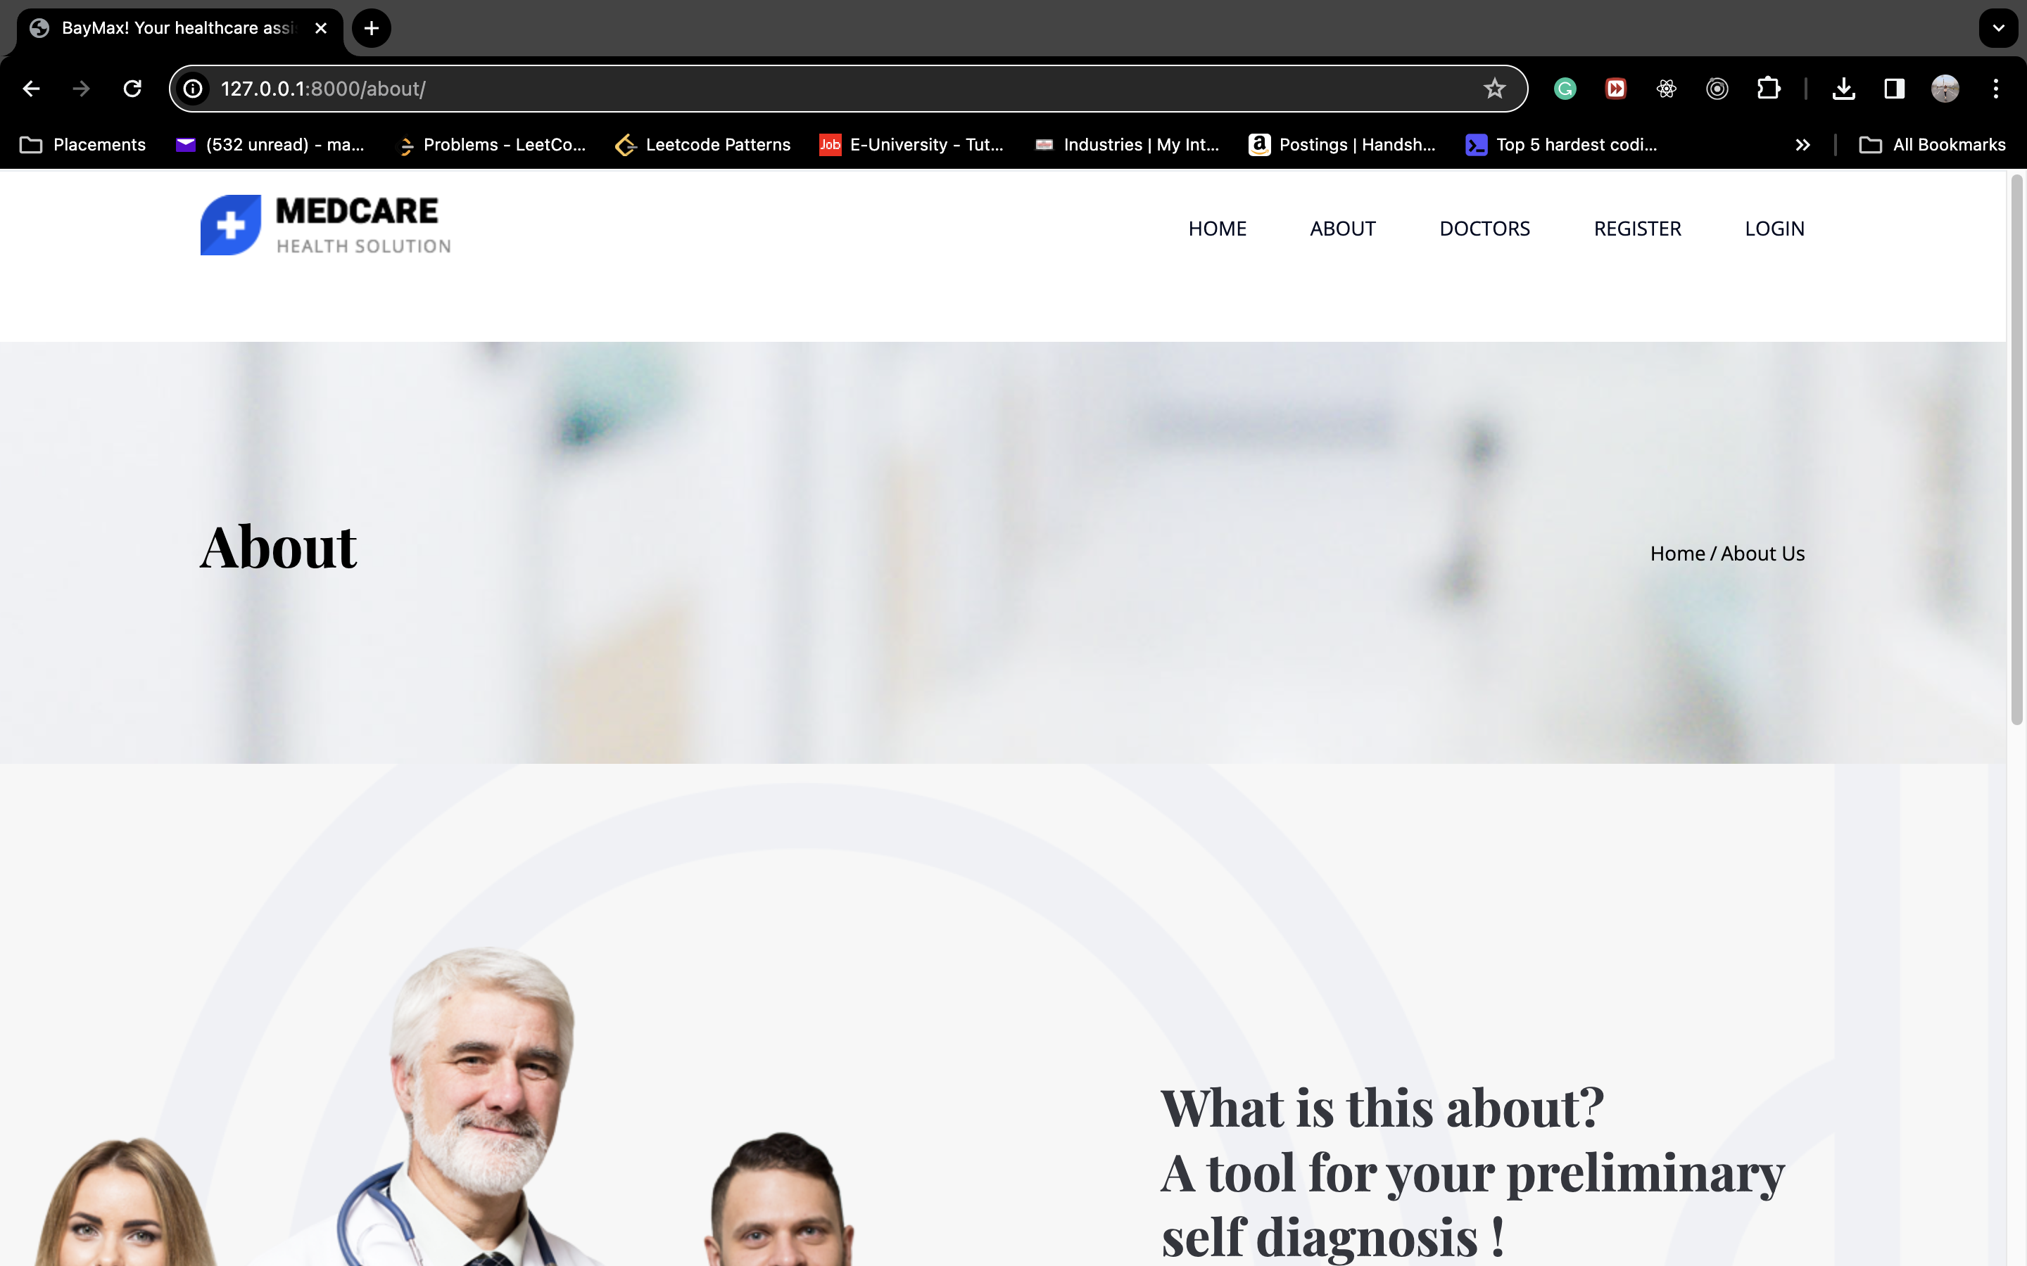
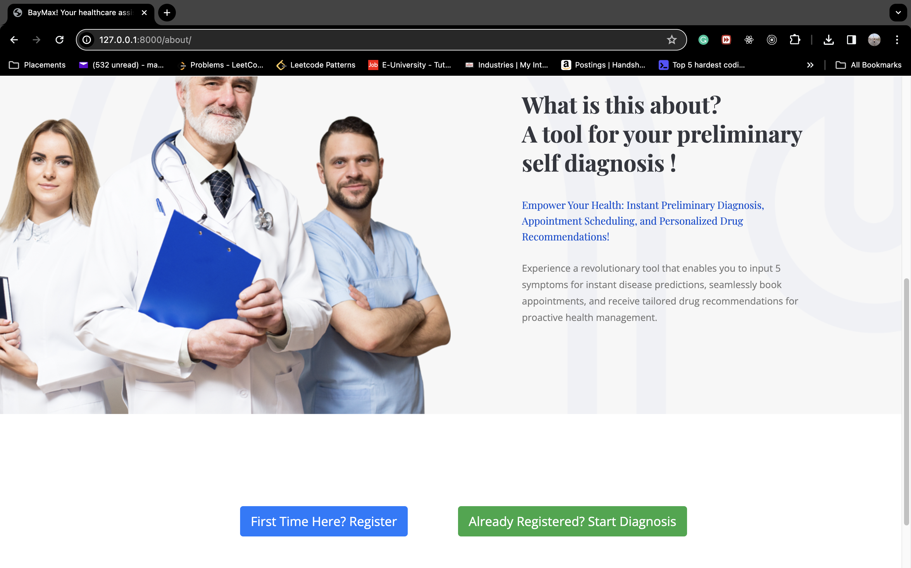
PATIENT OUTPUT PT. 1
Home page of the website
About page of the website

Slide 8
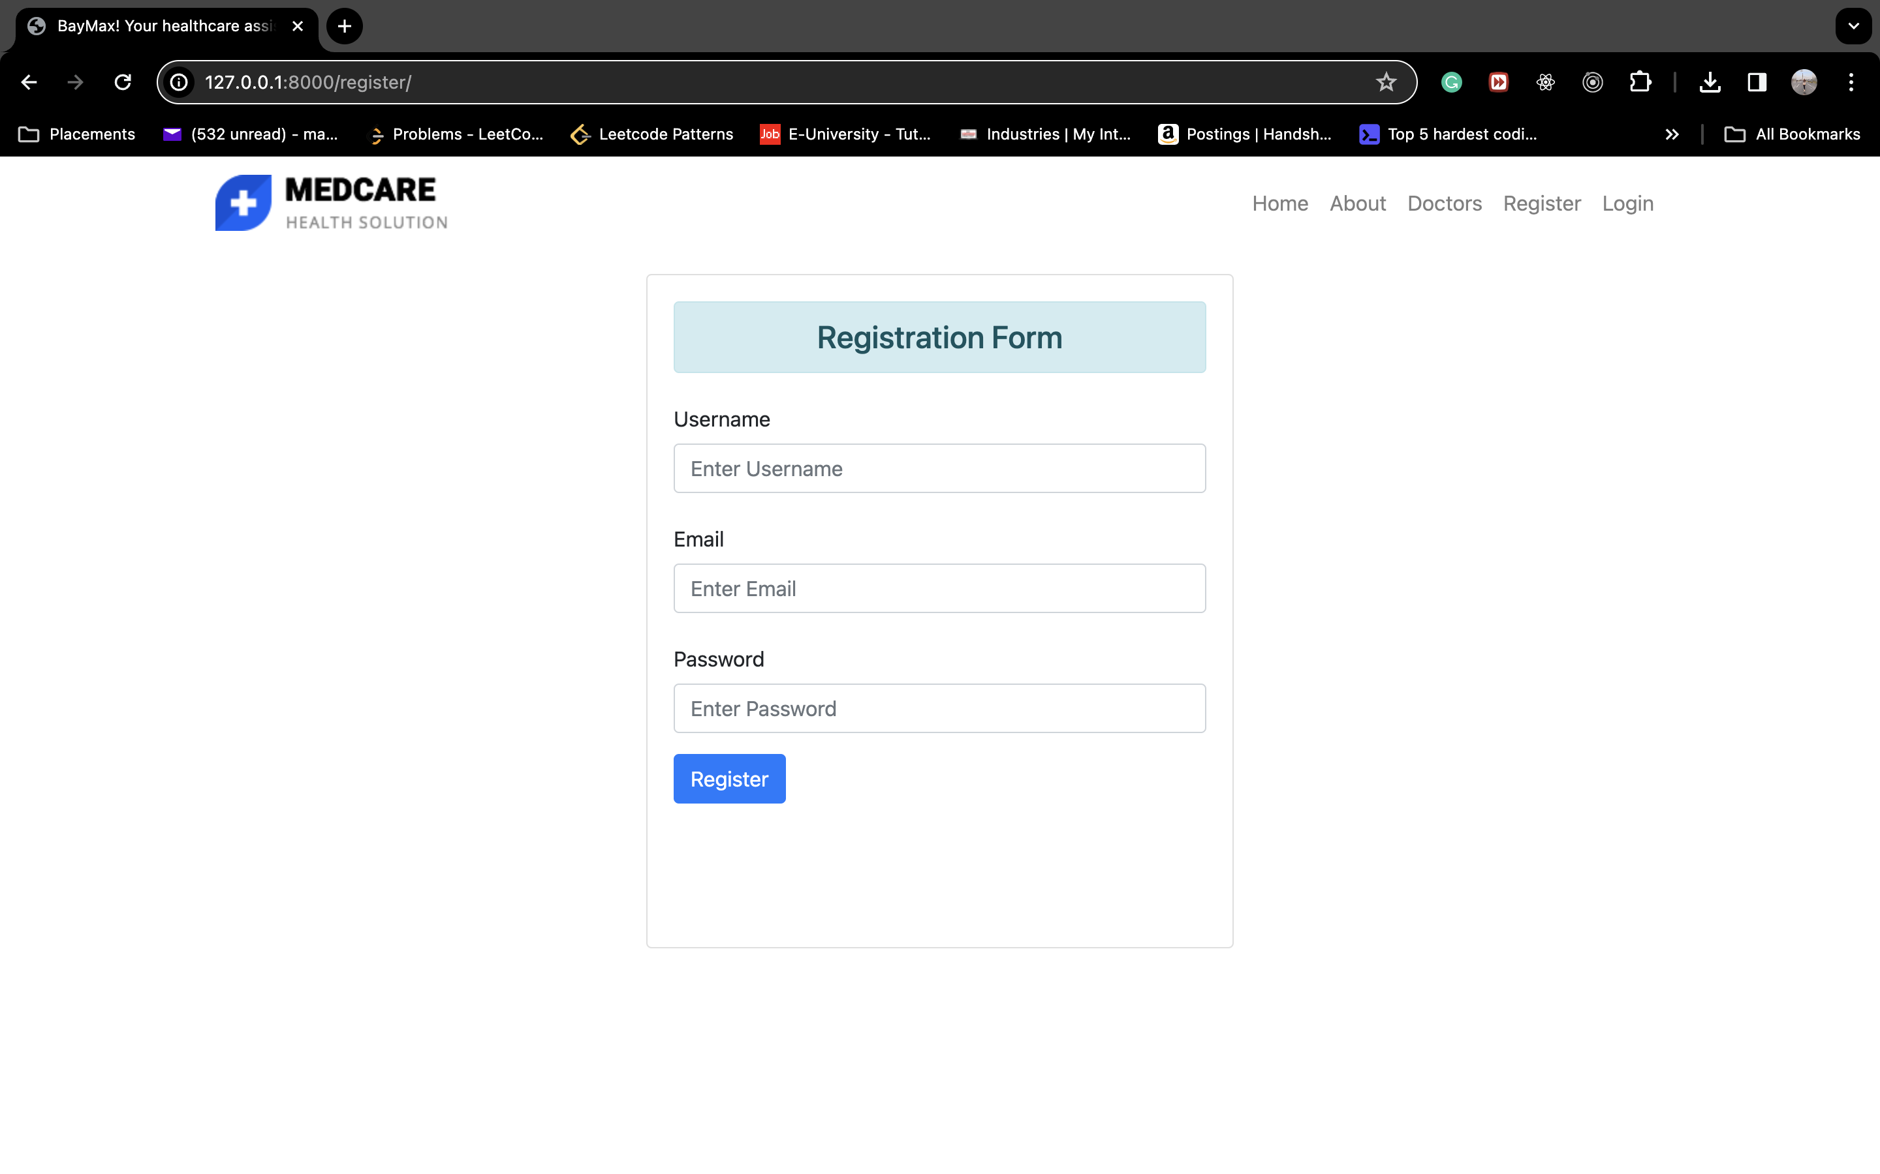
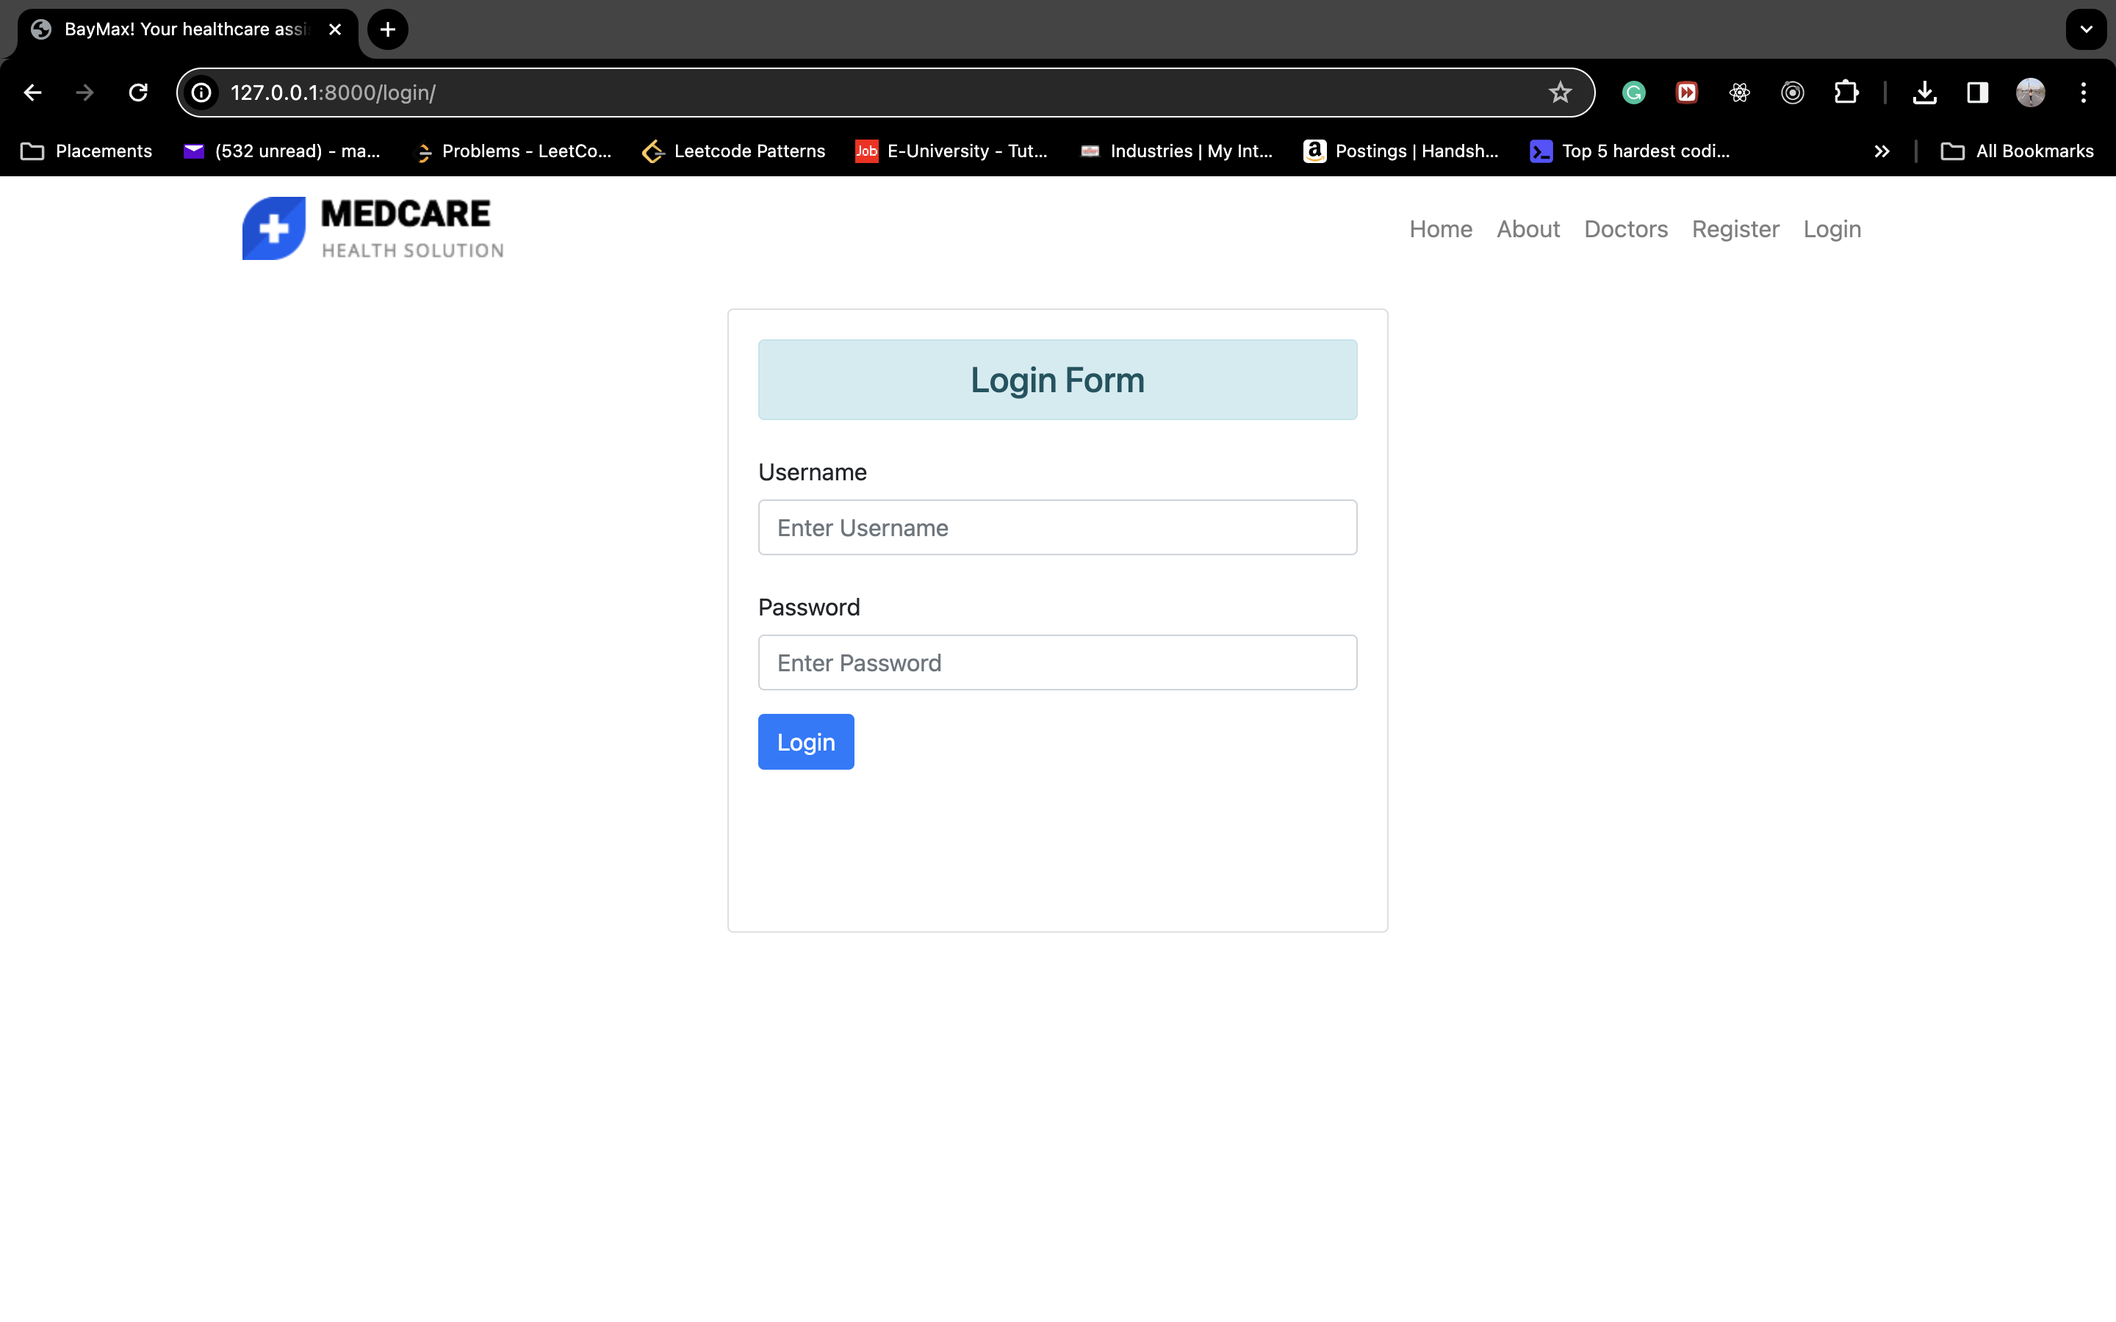
PATIENT OUTPUT PT. 2
Registration page
Login Page

Slide 9
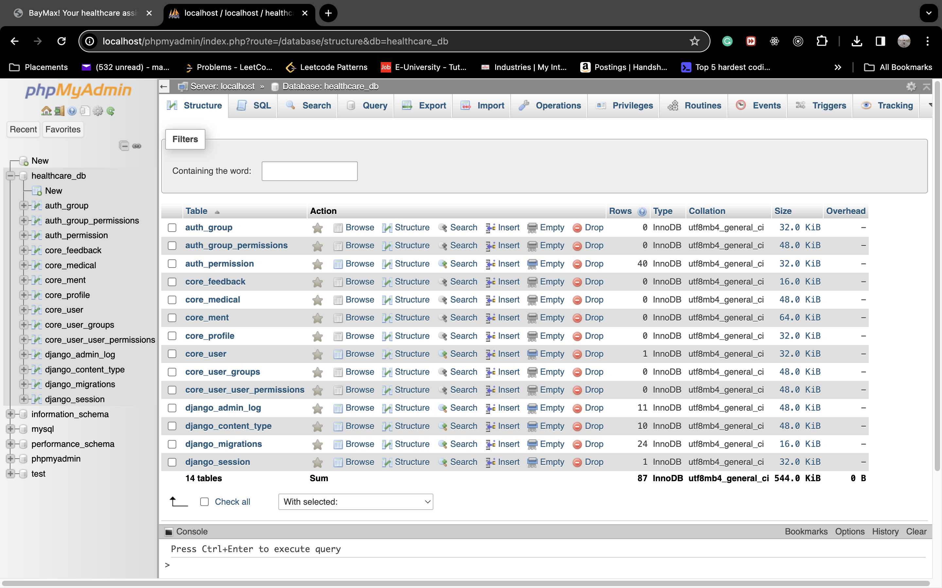
PATIENT OUTPUT PT. 3
Database structure

Slide 10
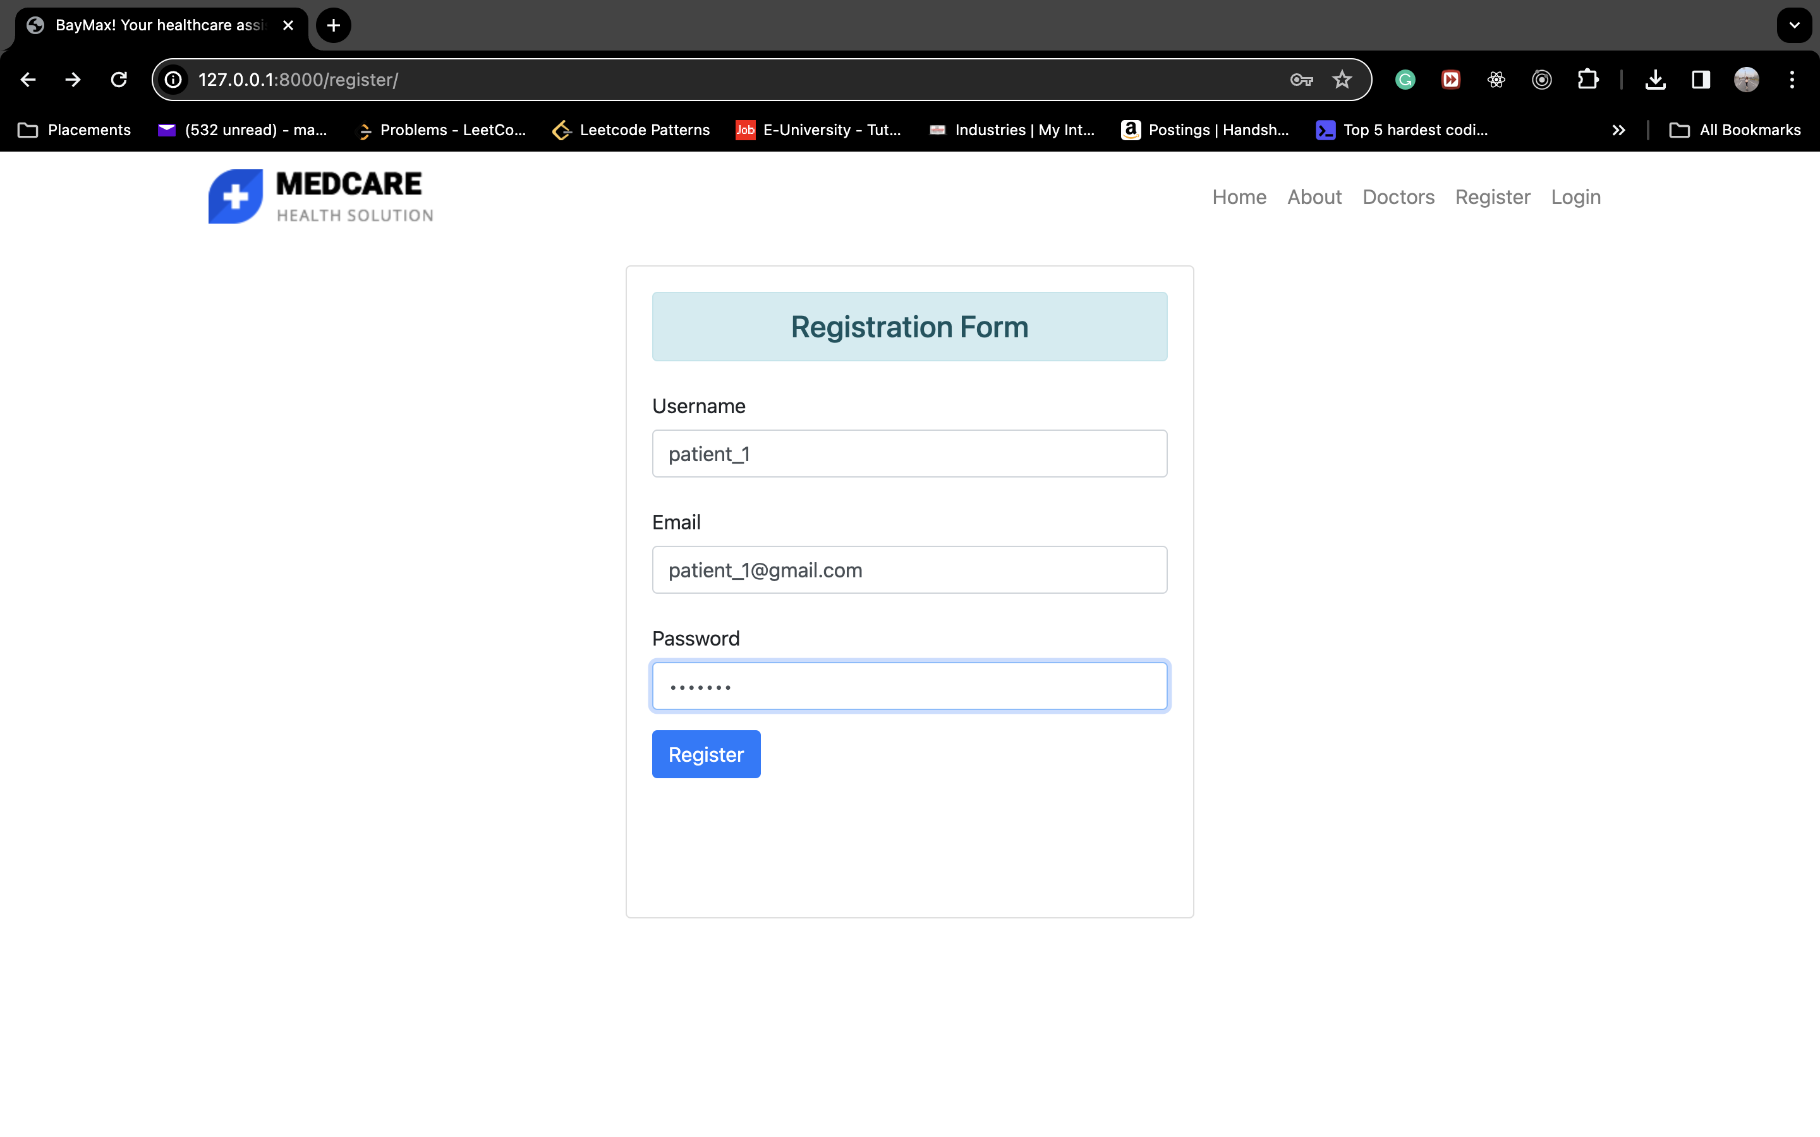
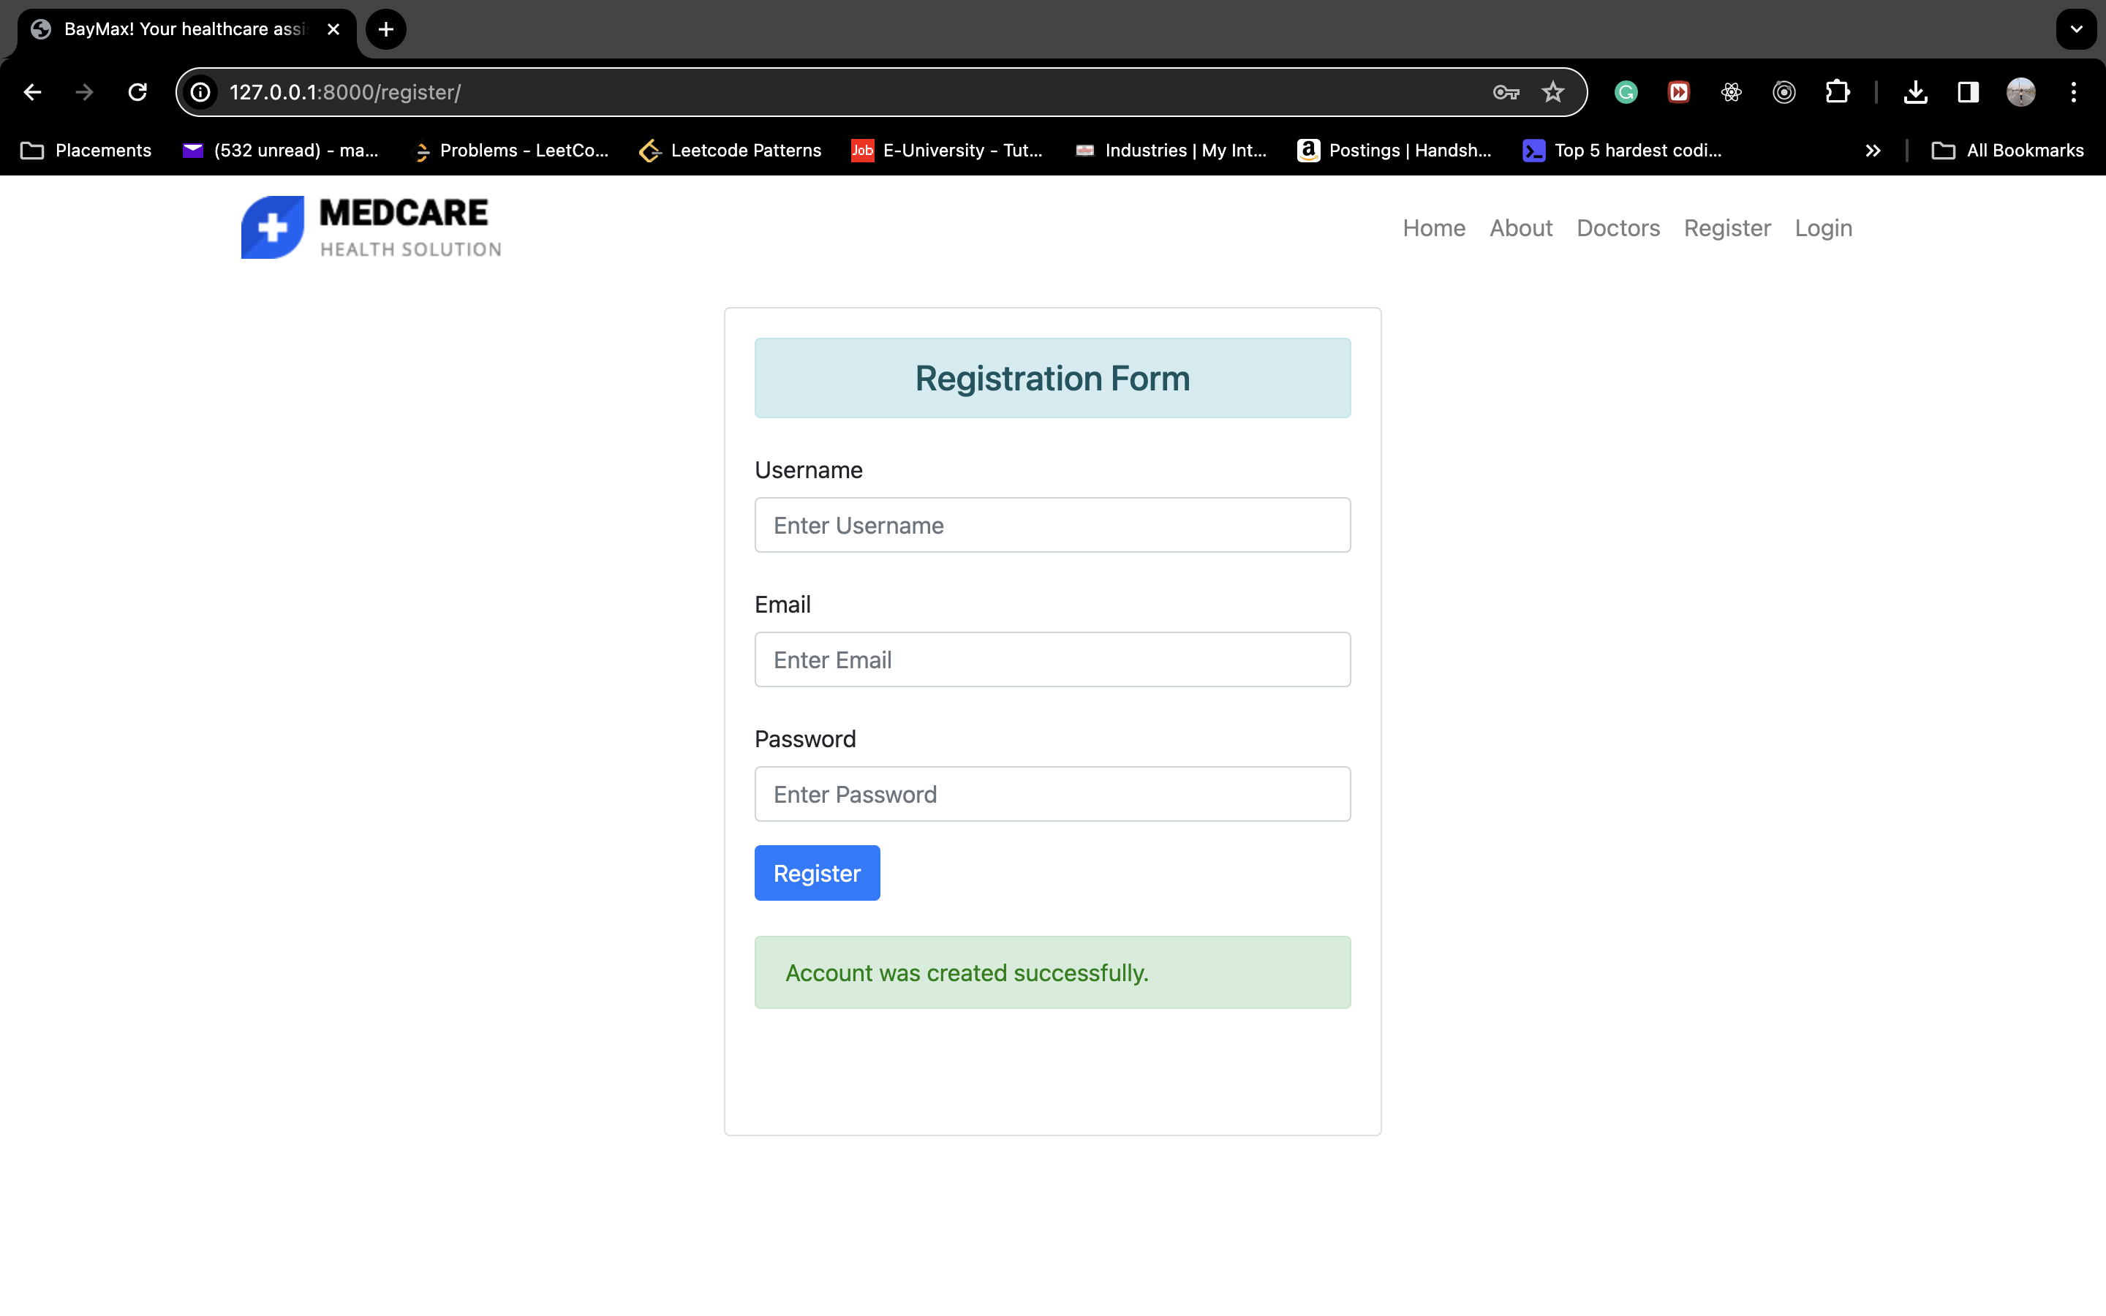
PATIENT OUTPUT PT. 4
Registering a user

Slide 11
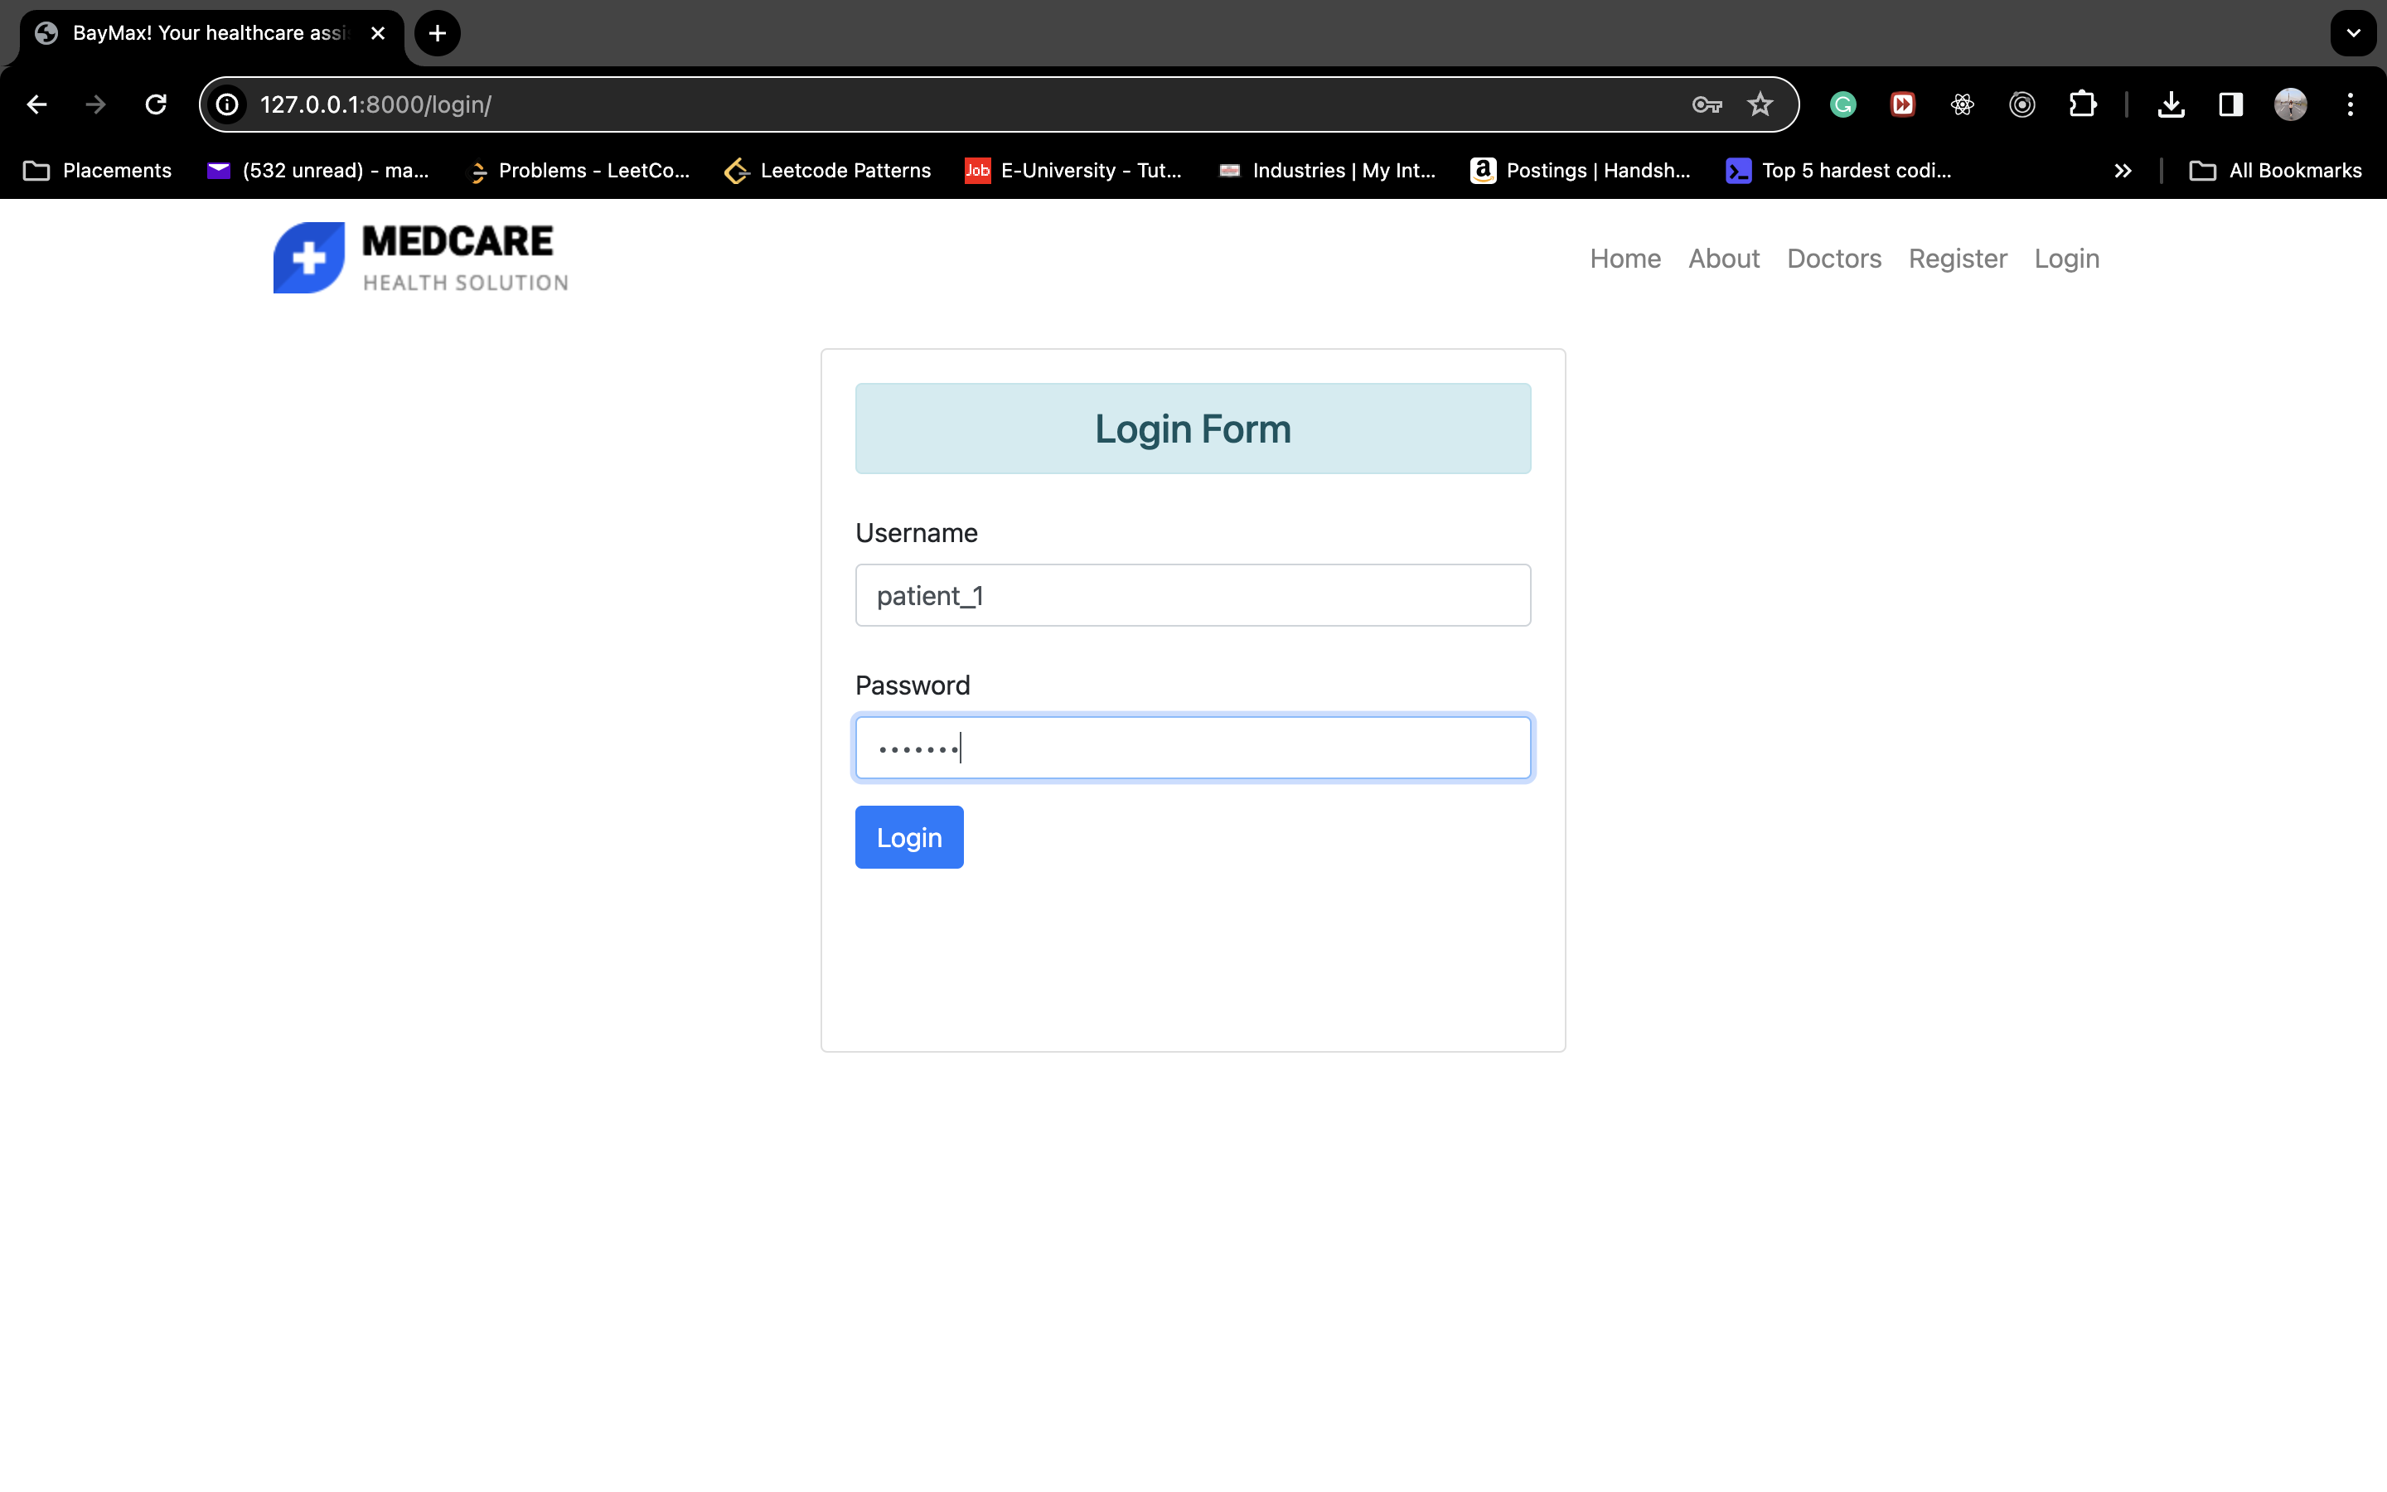
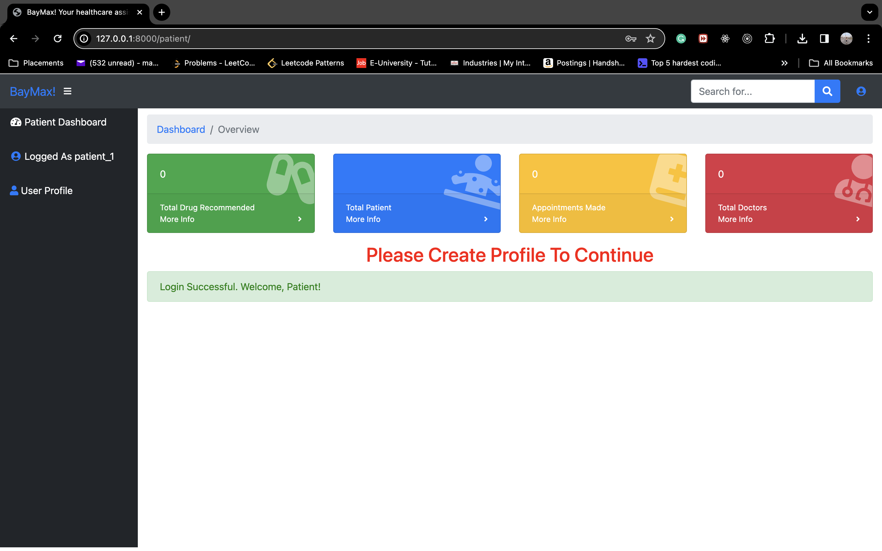
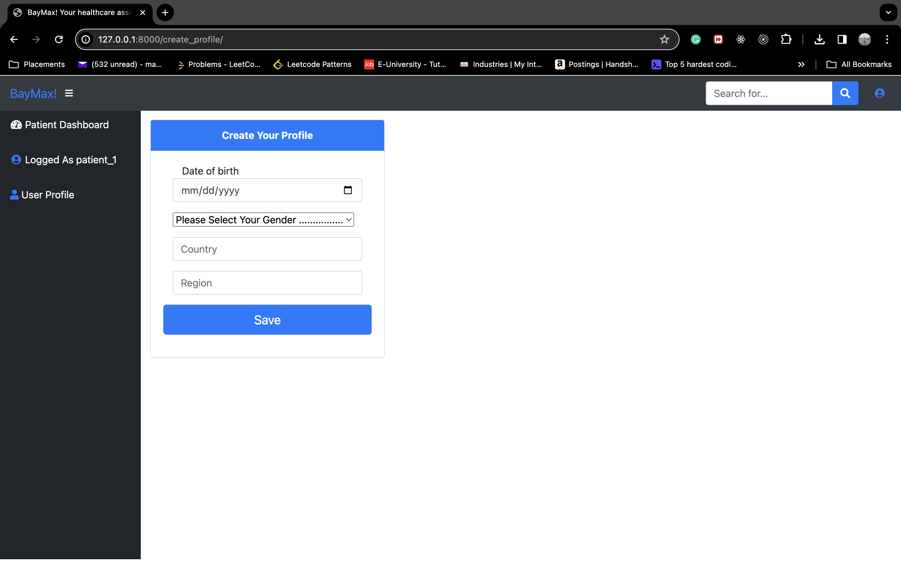
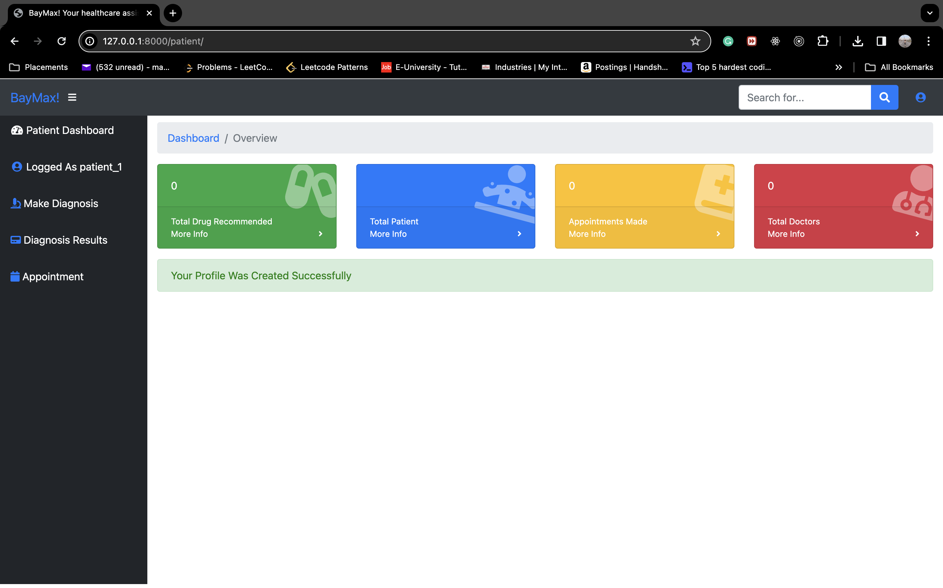
PATIENT OUTPUT PT. 5
Logging In and Creating a profile

Slide 12
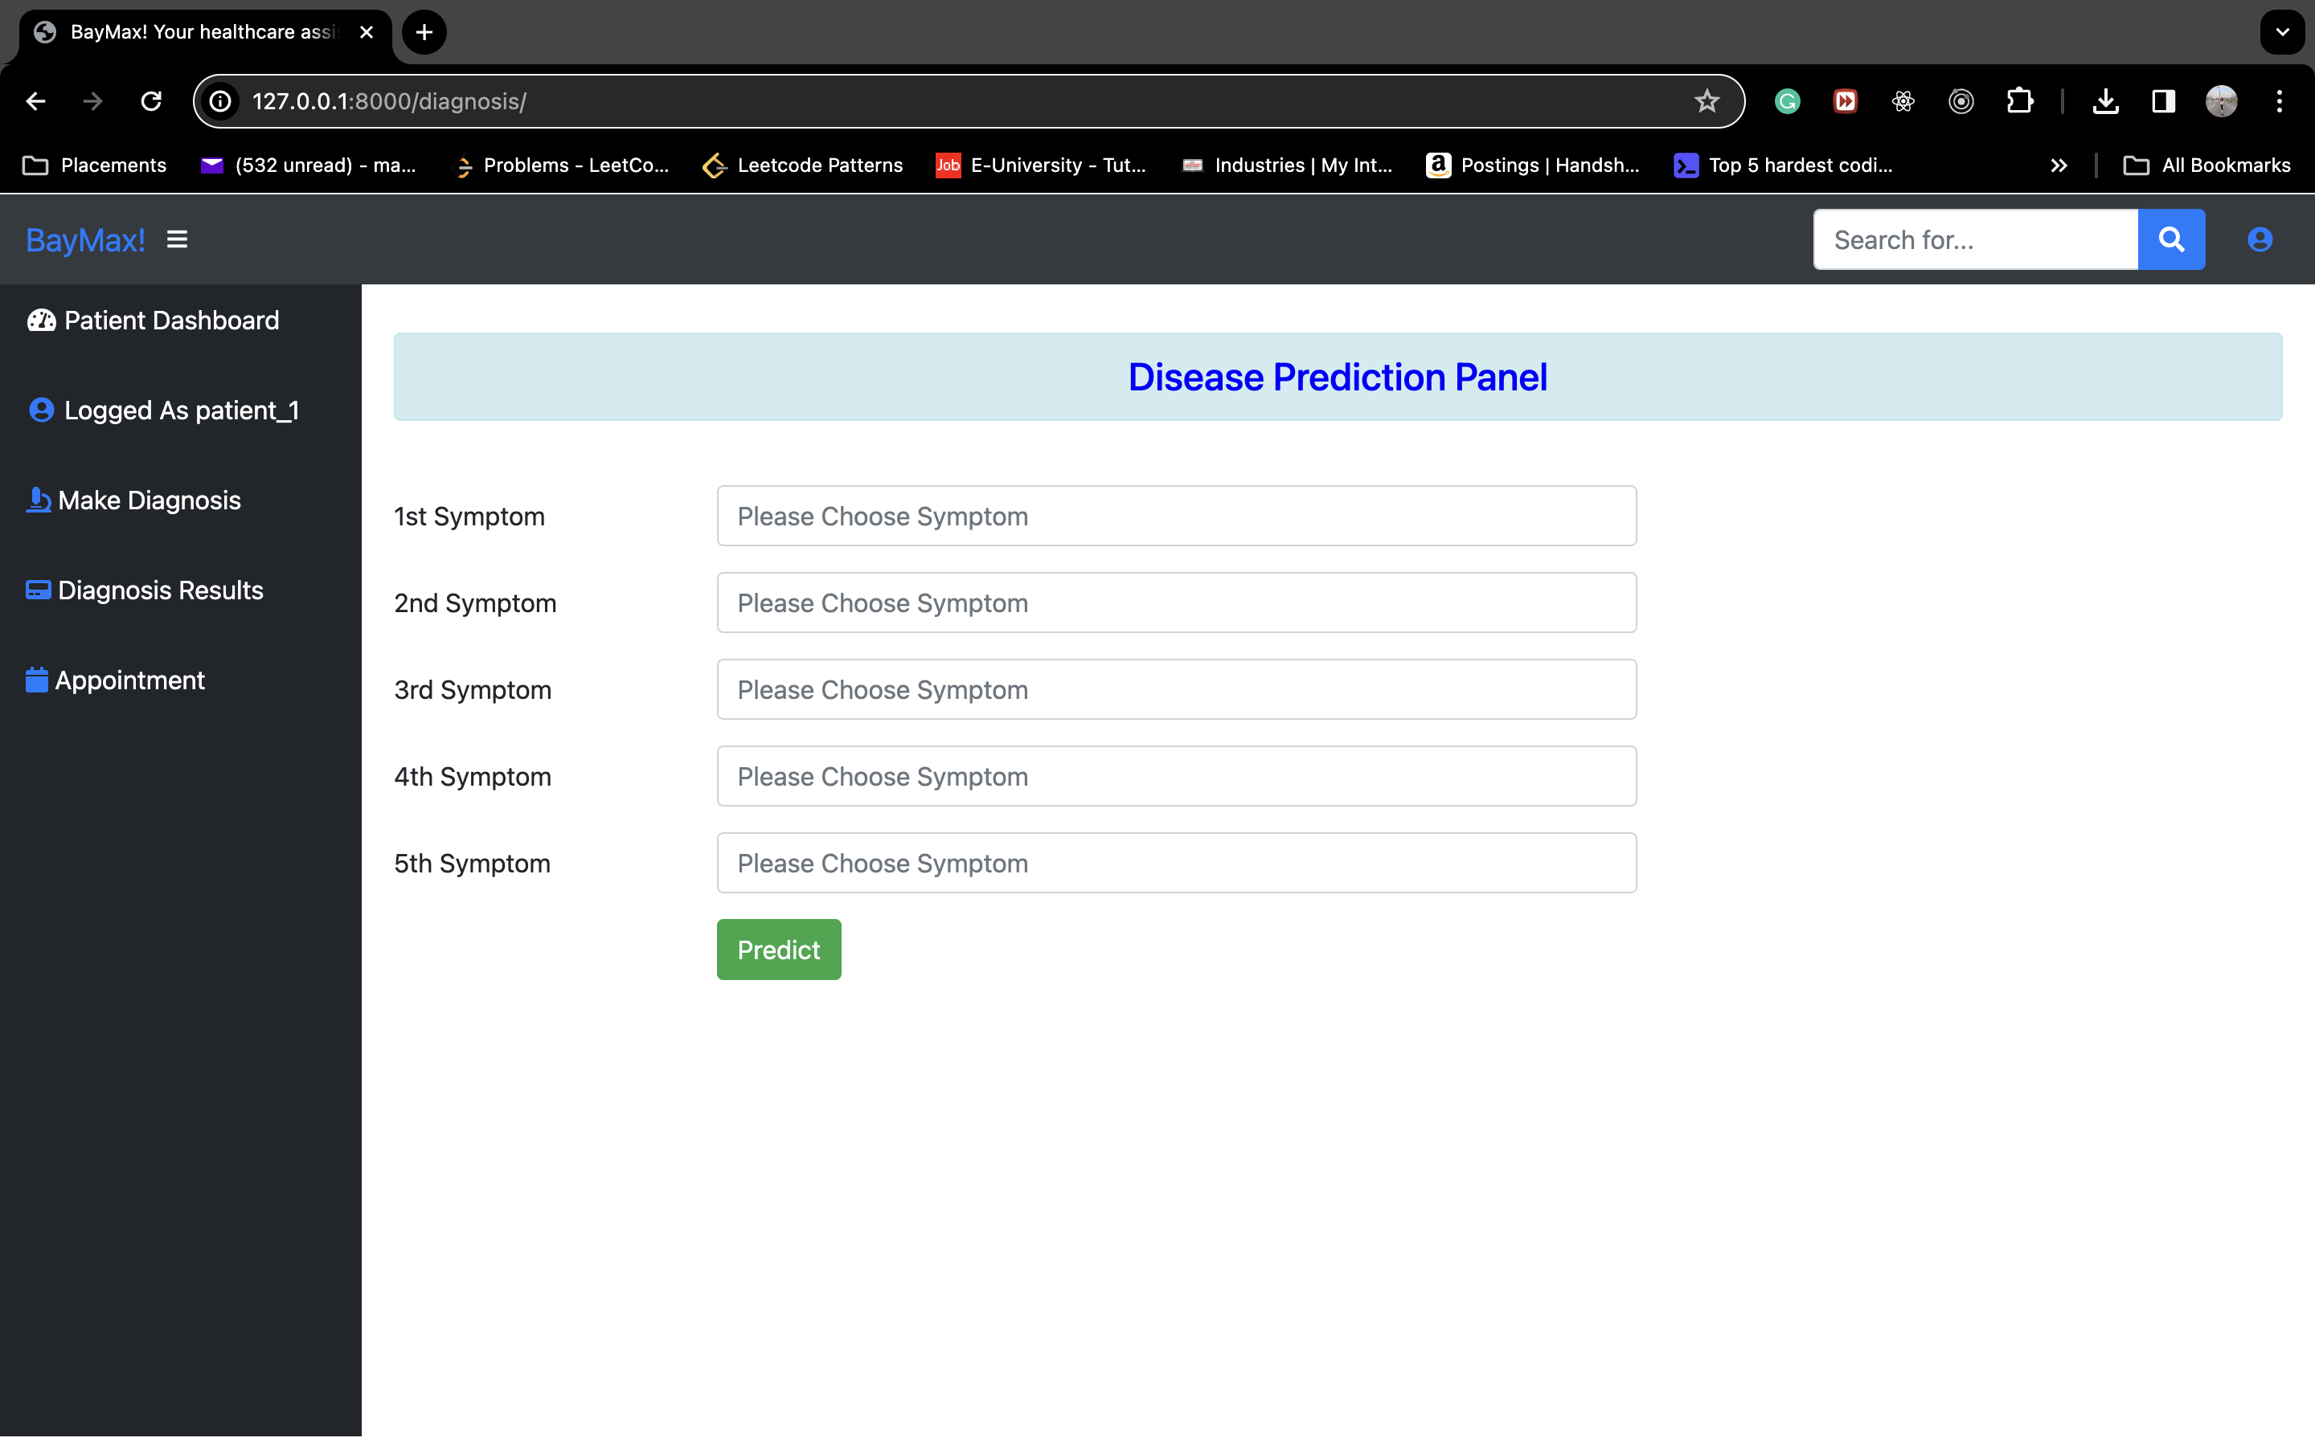
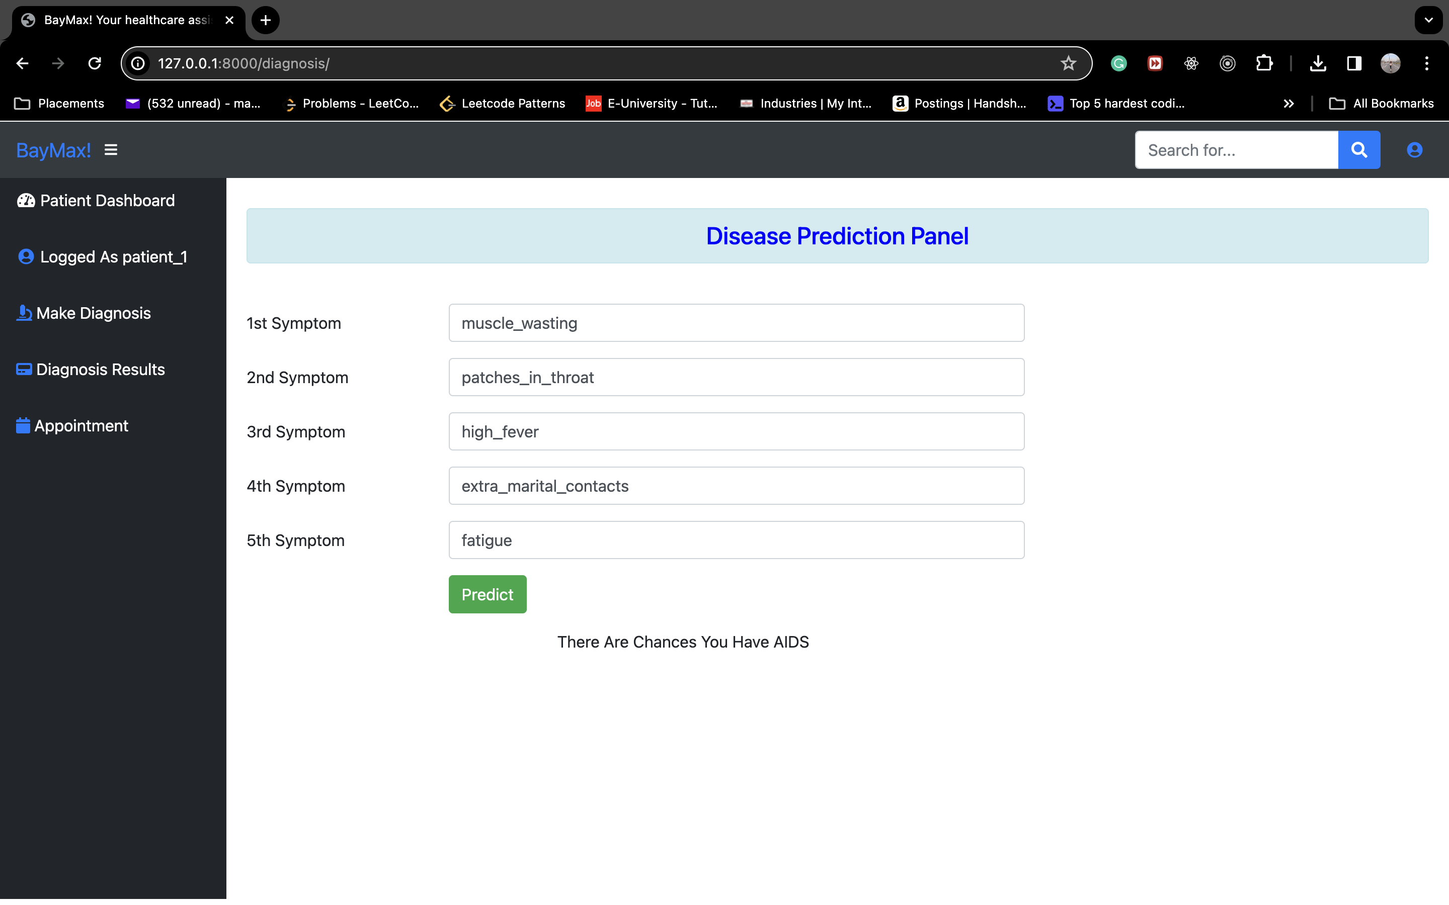
PATIENT OUTPUT PT. 6
Disease Prediction

Slide 13
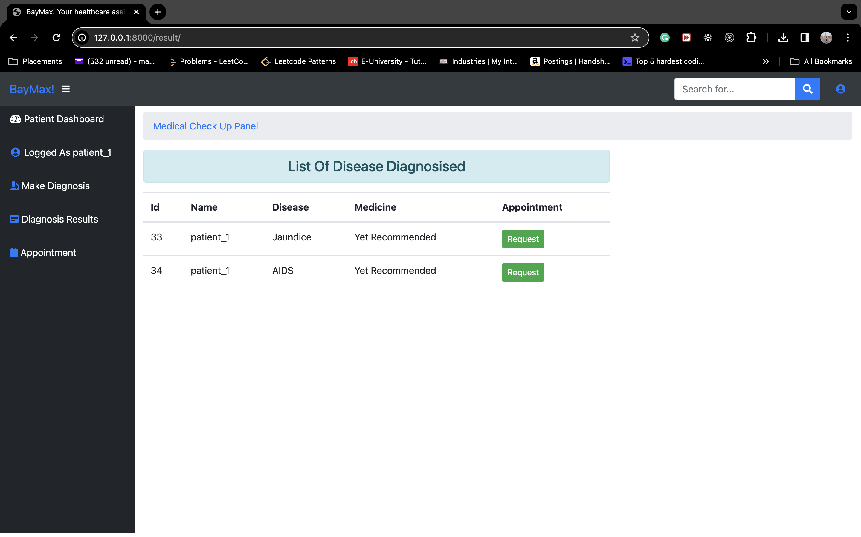
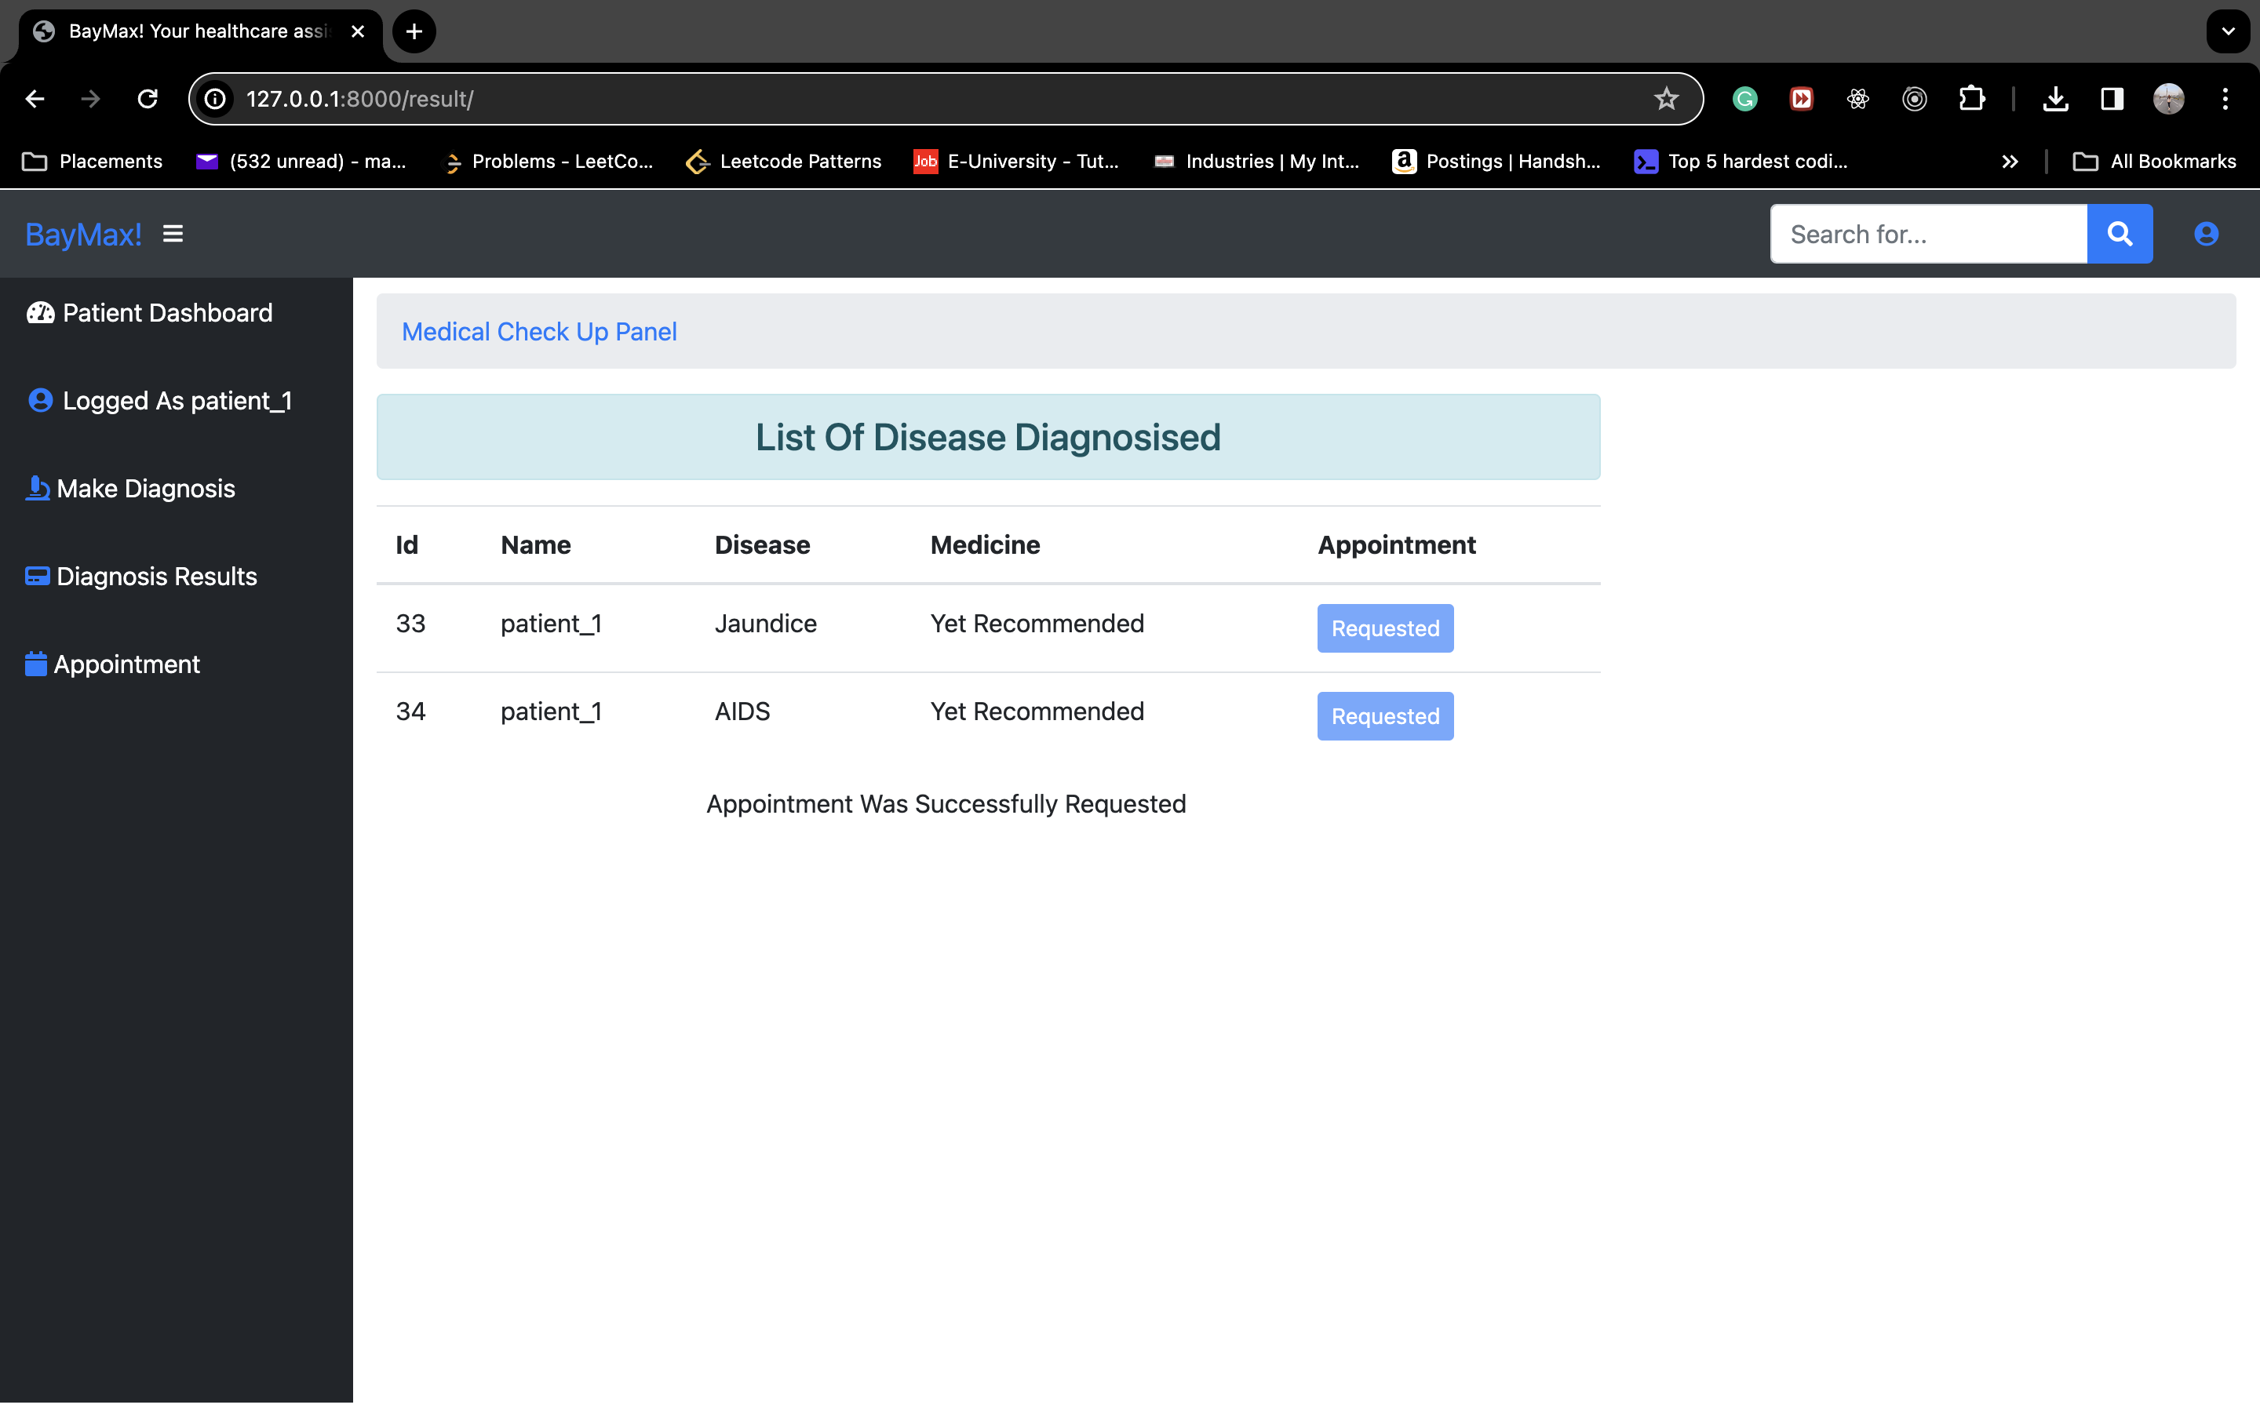
PATIENT OUTPUT PT. 7
Requesting Appointment

Slide 14

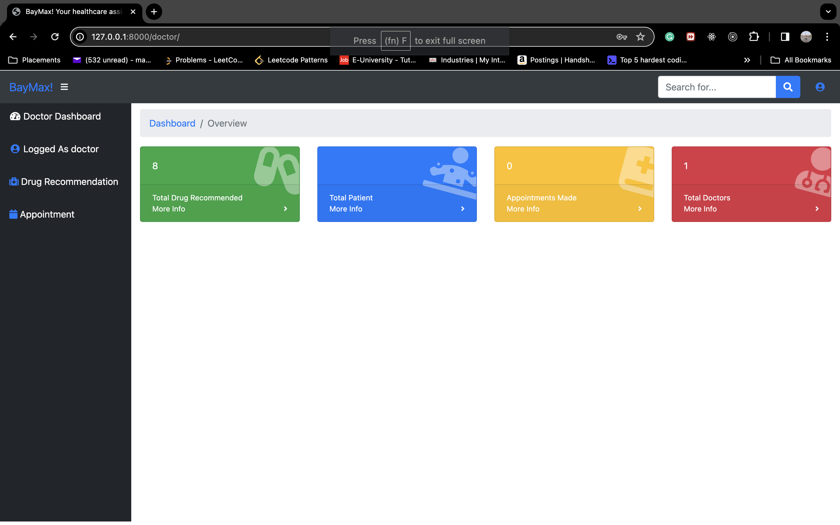
DOCTOR OUTPUT PT. 1
Registering and log in as a doctor

Slide 15
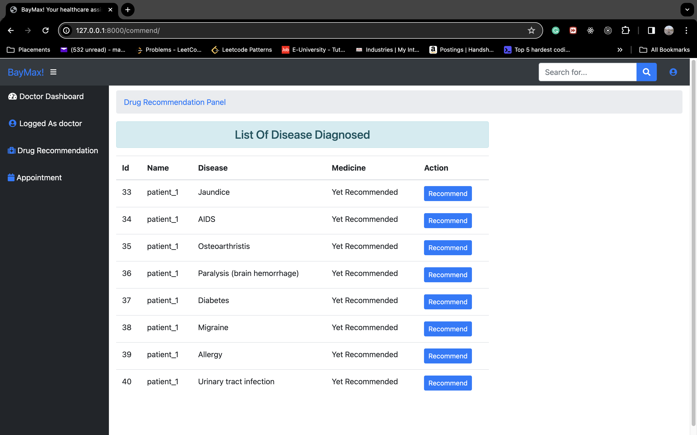
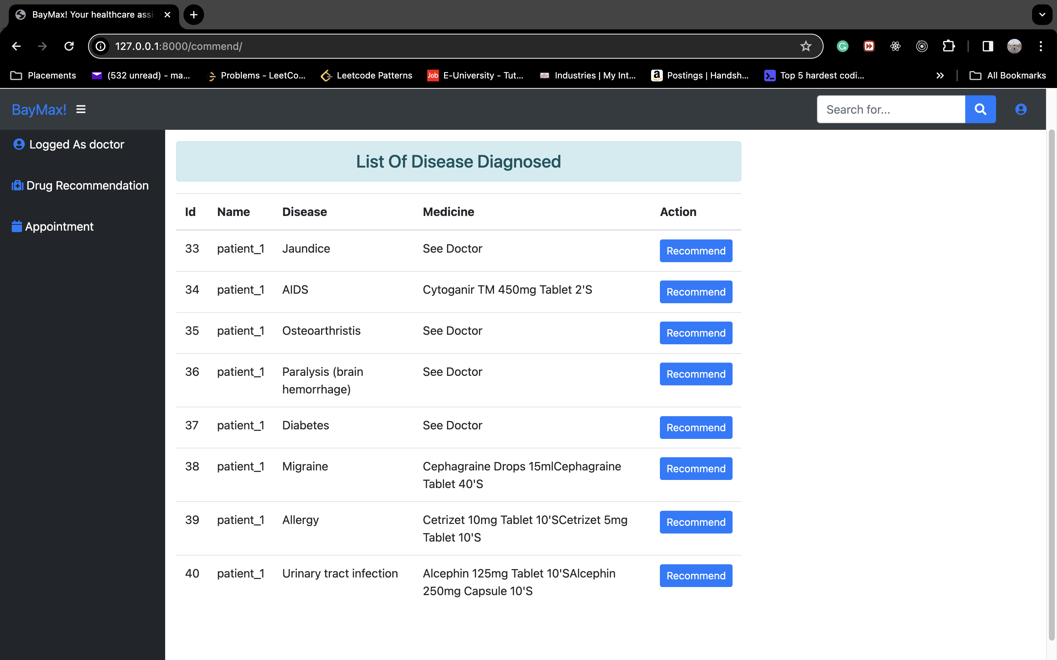
DOCTOR OUTPUT PT. 2
Doctor recommending drugs to patients

Slide 16
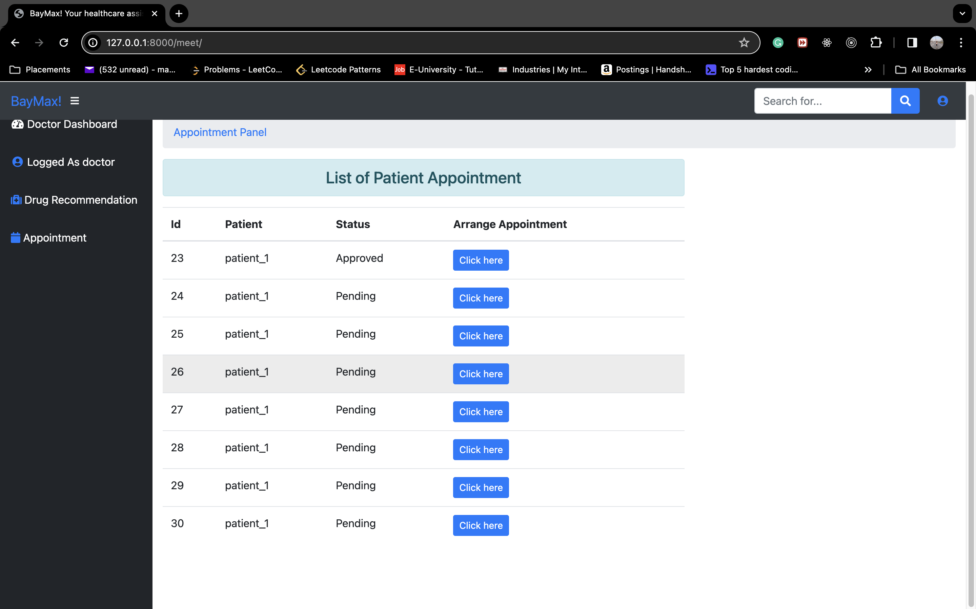
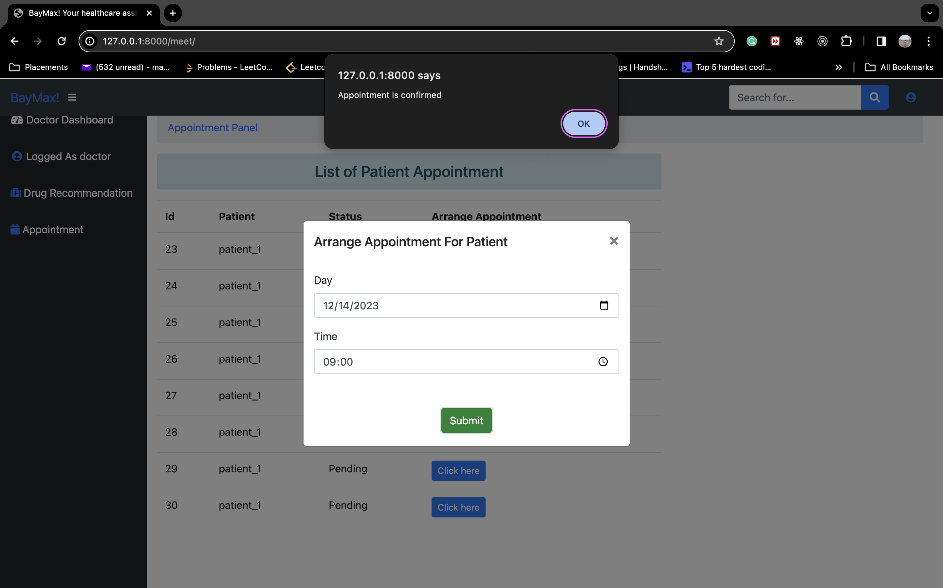
DOCTOR OUTPUT PT. 3
Doctor setting appointments

Slide 17
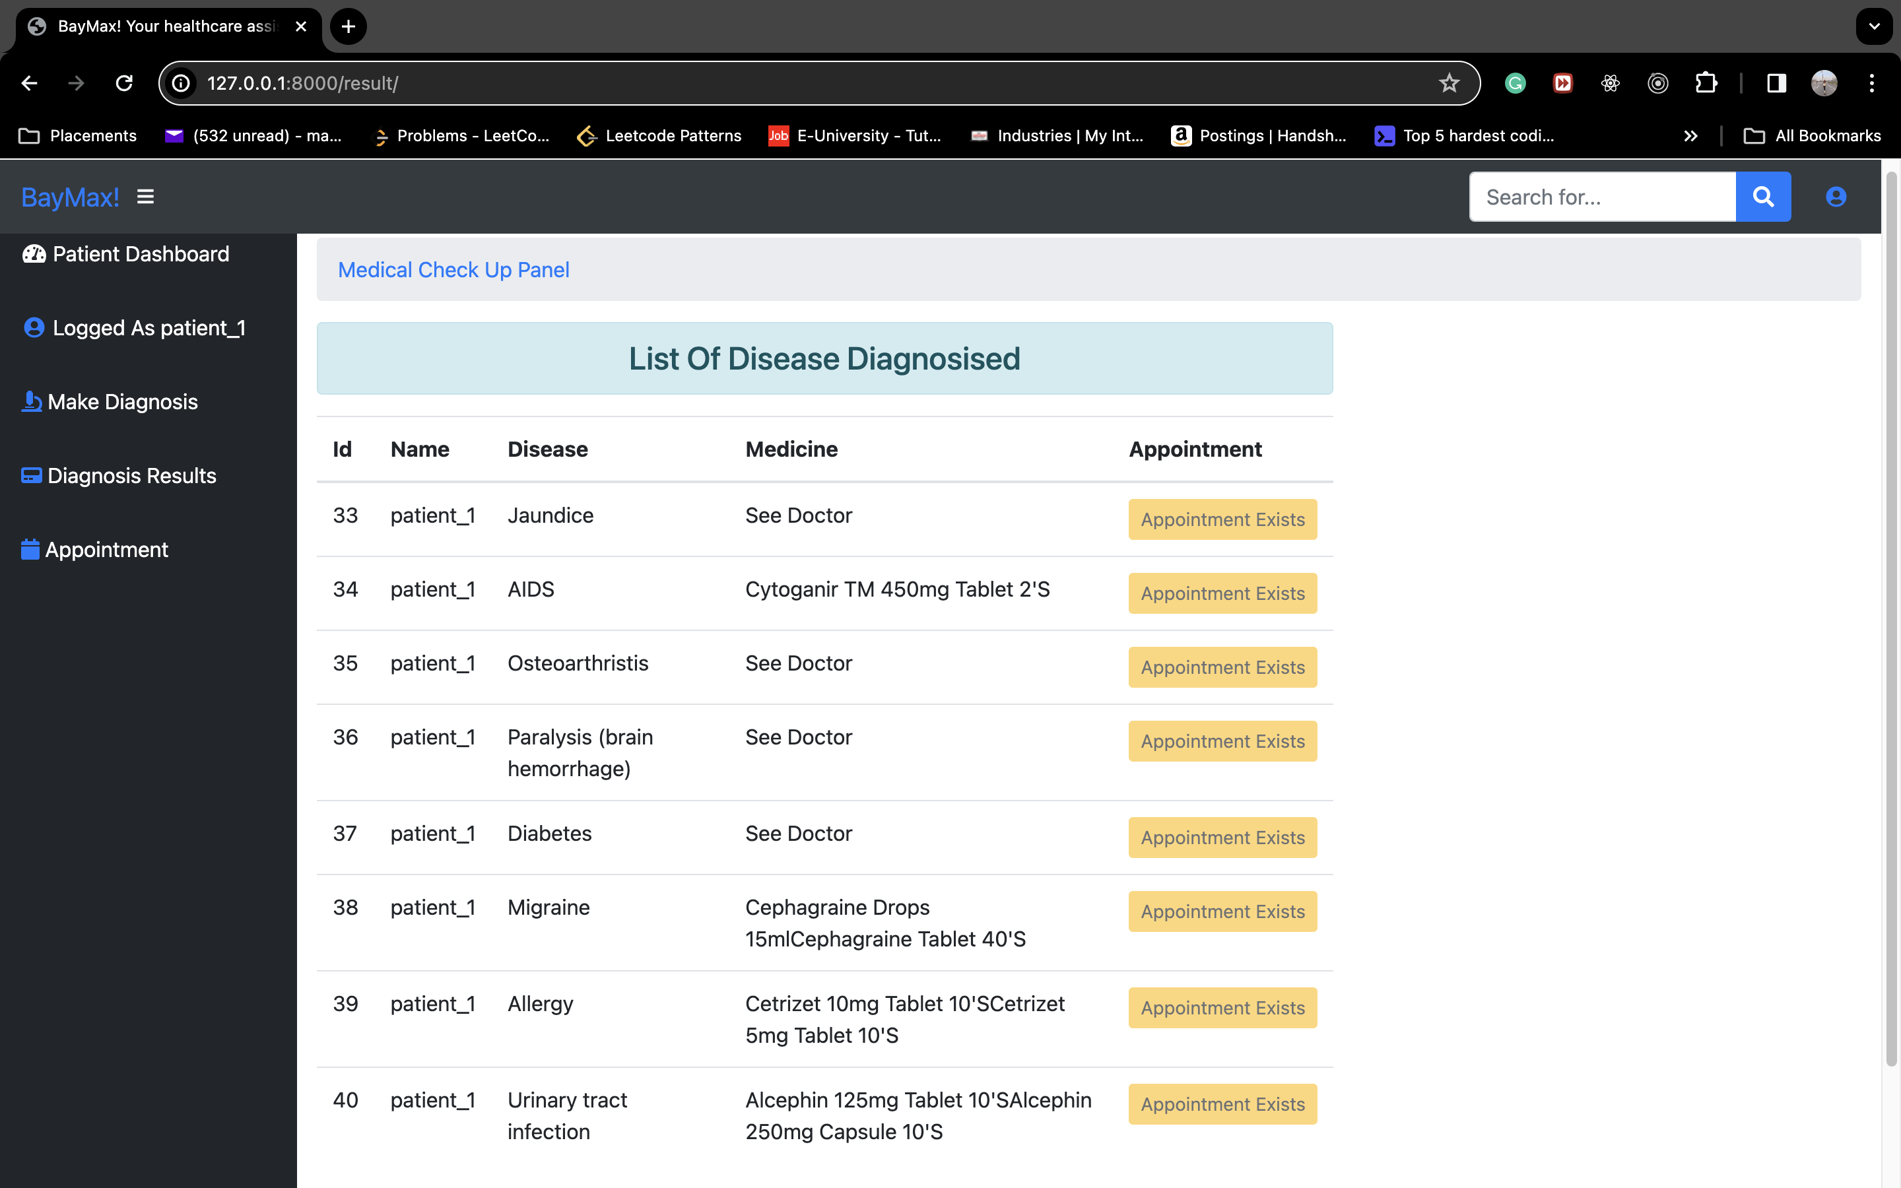
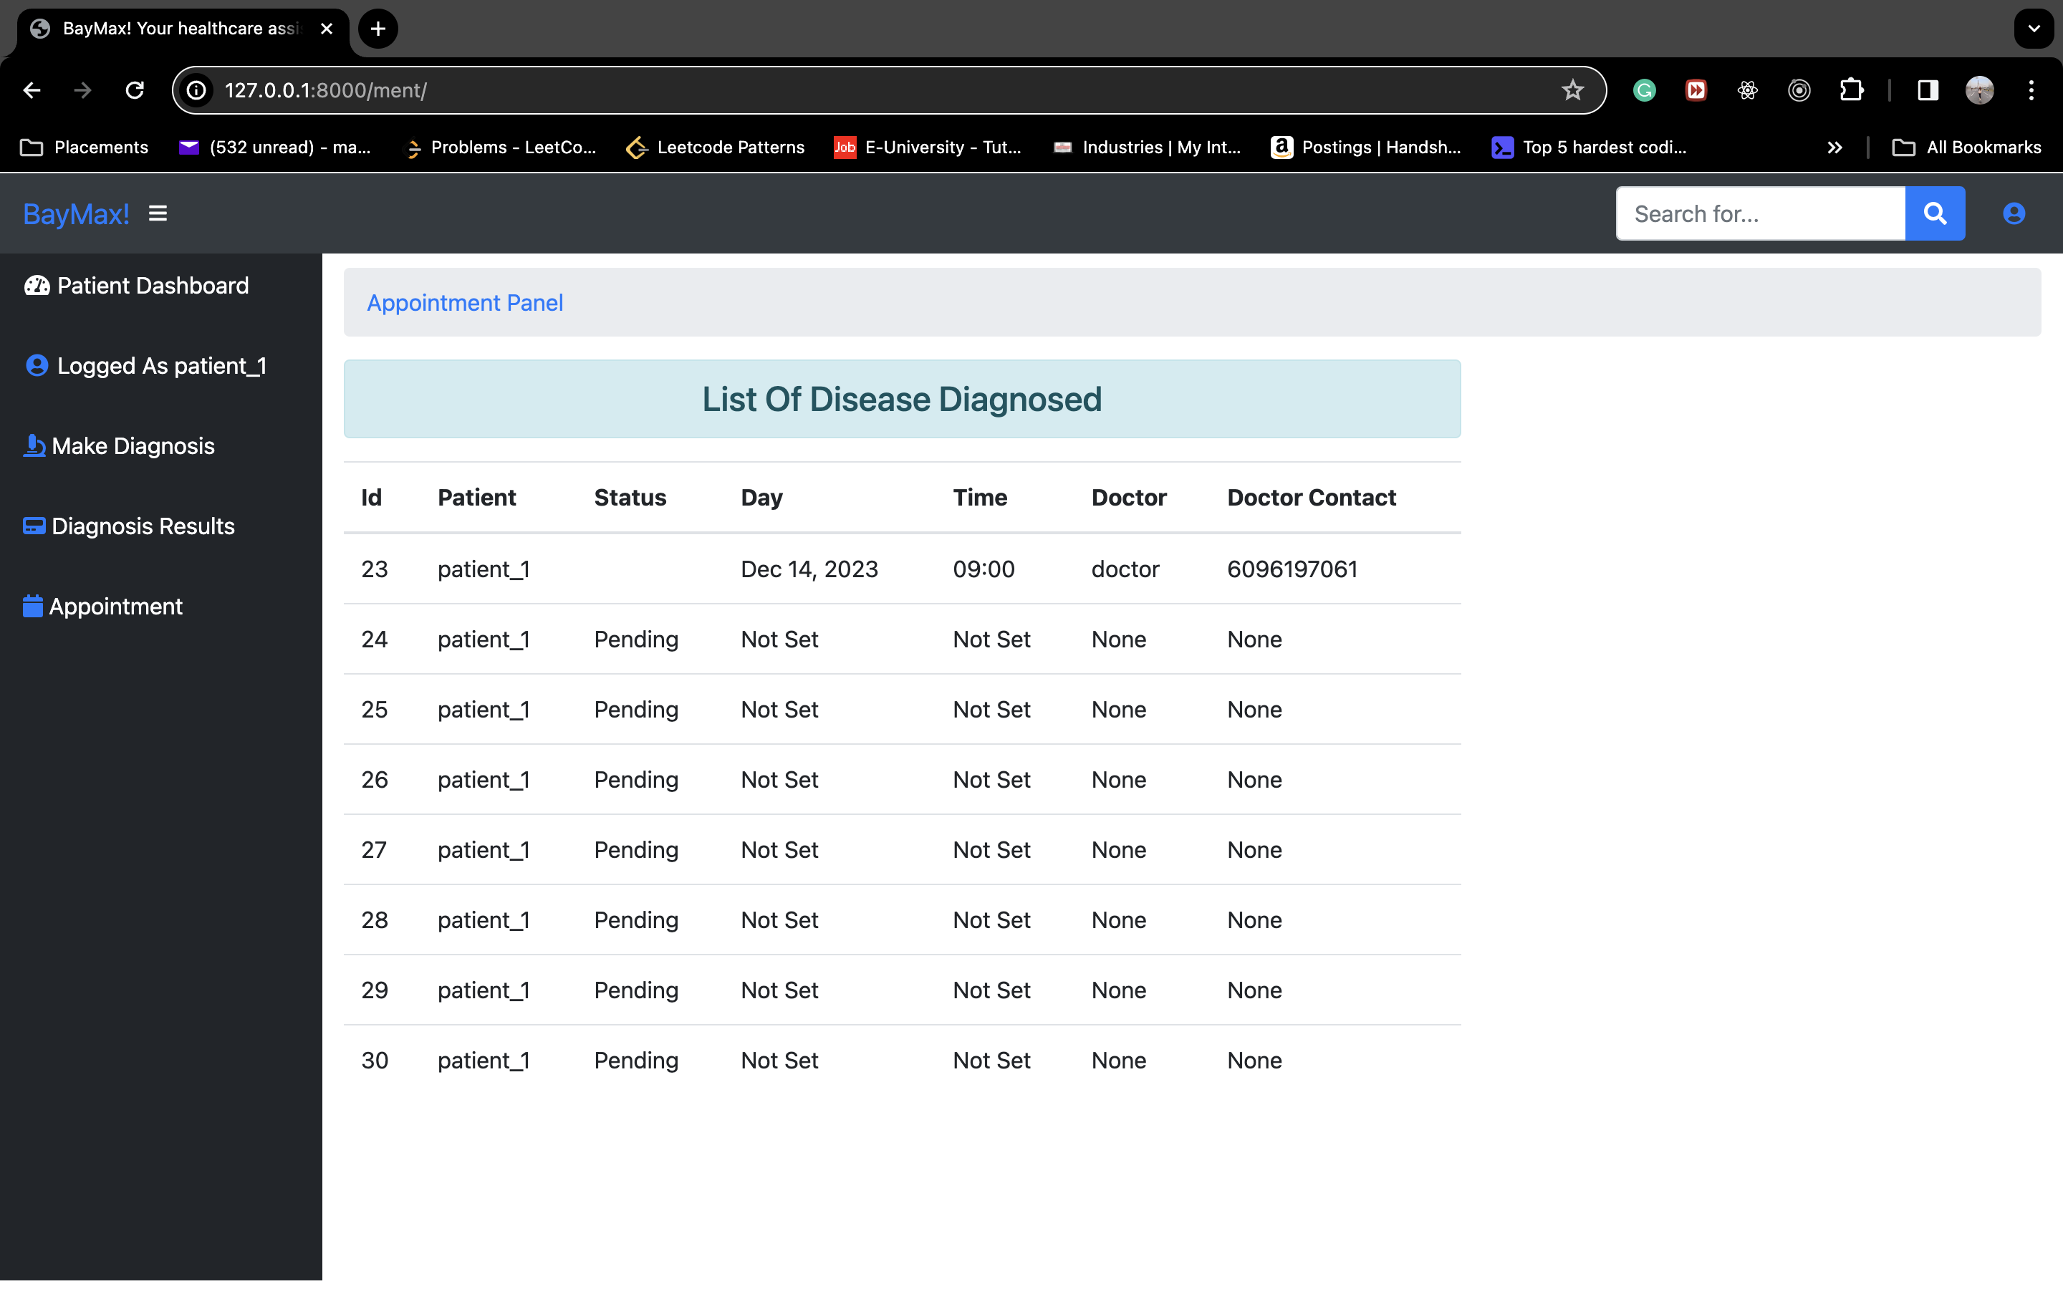
PATIENT OUTPUT PT. 8
Patient being able to view recommended drugs and appointments set by Doctor

Slide 18
FUTURE WORK
Dynamic Drug Recommendation System:
Develop a more dynamic drug recommendation system by incorporating patient history, genetic information, and potential drug interactions for more accurate and personalized suggestions.
Advanced Disease Treatments Integration:
Investigate integrating advanced and specific disease treatments, focusing on conditions like cancer, tumors, and other specialized medical scenarios.
Incorporate cutting-edge treatment protocols and personalized care plans and insurance plans into the BayMax platform.
X-ray Reading and Report Processing::
Implement a feature allowing patients to upload medical reports, specifically focusing on X-ray images.
Integrate machine learning algorithms for automated X-ray analysis to assist healthcare providers in diagnostics.

Slide 19

CONCLUSION
BayMax represents a shift in healthcare, seamlessly merging advanced technology with medical insights to provide accessible and personalized healthcare solutions.
The project's success lies in integrating robust disease prediction models and dynamic drug recommendation systems, offering users a proactive approach to health management.
Future work, including integrating specialized disease treatments and diagnostic image processing, positions BayMax as an evolving healthcare ecosystem ready to meet diverse medical needs.
BayMax envisions a future where technology empowers individuals, fosters collaboration with healthcare professionals, and contributes to positive changes in healthcare delivery worldwide.

Slide 20
REFERENCES
[1] Shahadat Uddin1* , Arif Khan1,2, Md Ekramul Hossain1 and Mohammad Ali Moni3, “Comparing different supervised machine learning algorithms for disease prediction”, 2019
[2] Kedar Pingale1, Sushant Surwase2, Vaibhav Kulkarni3, Saurabh Sarage4, Prof. Abhijeet Karve5, “Disease Prediction using Machine Learning”, December 2019
[3] K.Sowmya, Saragadam Sridhar, “Drug Recommendation System Using Machine Learning Based On Tf-idffeature Extraction Process”,July 2023

Slide 21
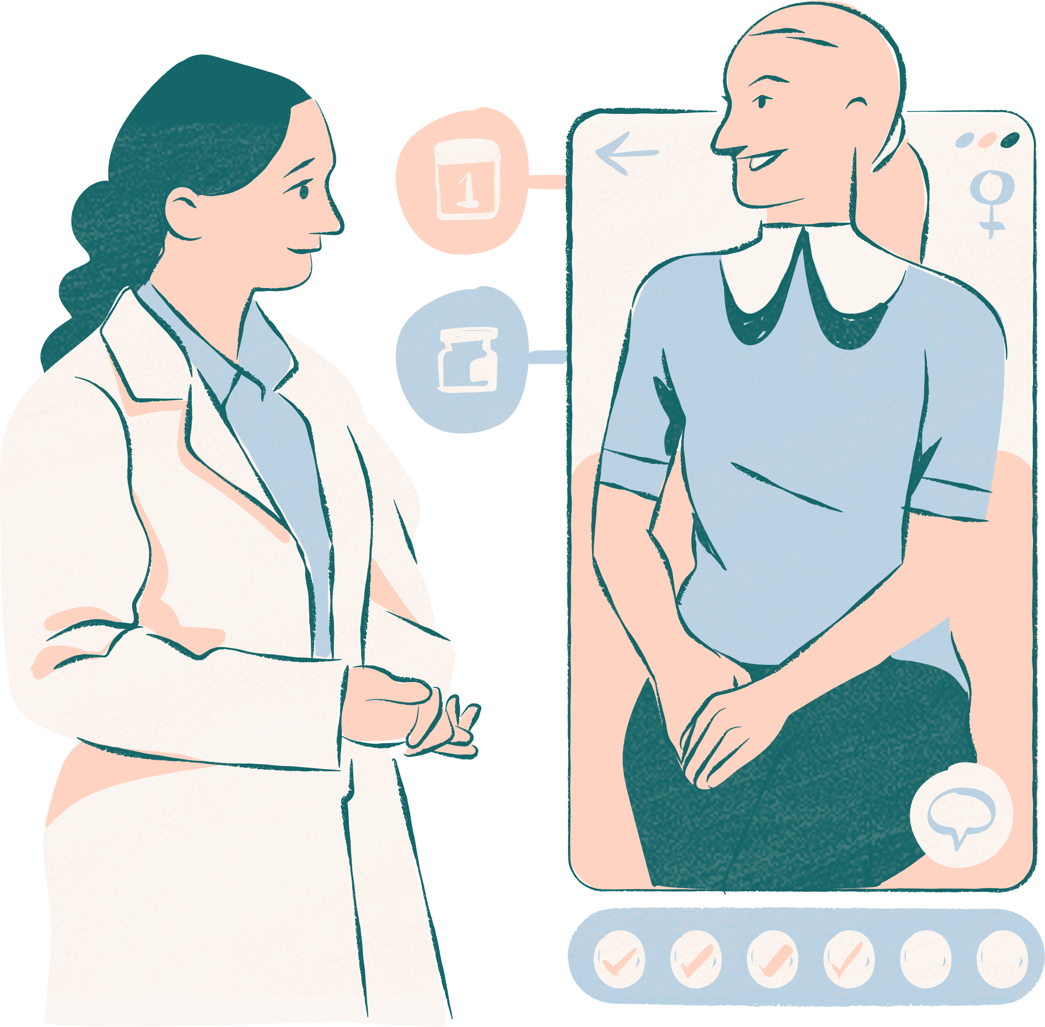
Thank you very much!

